Slide 1
Evidence Based Medicine for rare diseases & Introduction to Artificial Intelligence
Adrien DE VOEGHT, MD
Clinical Hematology, CHU de Liège – Uliège
GIGA I3 – Hematology – Uliège
Montefiore Institute - Montefiore Institute of Electrical Engineering and Computer Science – Uliège
Adrien.devoeght@chuliege.be

Slide 2
Plan of the lesson
1. Evidence based medicine for rare diseases
What is EBM?
What are rare diseases?
How can we mix EBM with rare diseases?
2. Introduction to Artificial Intelligence
What is AI?
How it works?
Concrete examples of applications

Slide 3
Evidence Based Medicine – What is EBM?
1747
First controlled clinical trial in 1747 for scurvy
<1900
Before 1900, only few RCT were made
>1900
After 1900, RCT is no the rule and meta-analyses were introduced
1962
first law to rule empirical testing of clinical trial on humans
1970–1980
Archie Cochrane): first proposition for guiding clinical decisions
1991
G Guyatt introduced the term evidence-based Medicine
1992
Fundation of Cochrane centre
2004
Introduction of quality of evidence (Grades of recommendation assessment, Development and Evaluation)
2006
Development of the EQUATOR network

Slide 4
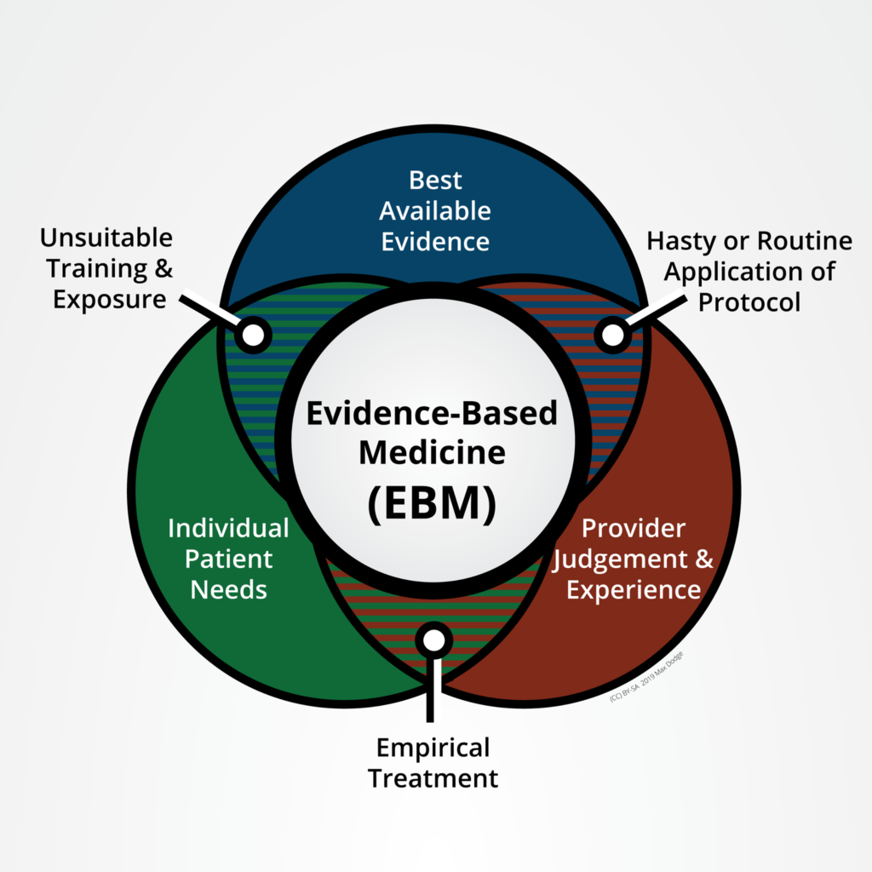
Evidence Based Medecine – What is EBM?
EBM = “application of the best available research to clinical care, which requires the integration of evidence with clinical expertise and patients values.”
What is EBM? | BMJ Best Practice
Djulbegovic B and Guyatt. Lancet. 2017

Slide 5
Evidence Based Medecine – What is EBM?
Best available research =
Accuracy and precision of diagnostic tests
Prognostic markers
Efficacy and safety of healthcare strategies
Understand the patient experience
What is EBM? | BMJ Best Practice
Djulbegovic B and Guyatt. Lancet. 2017

Slide 6
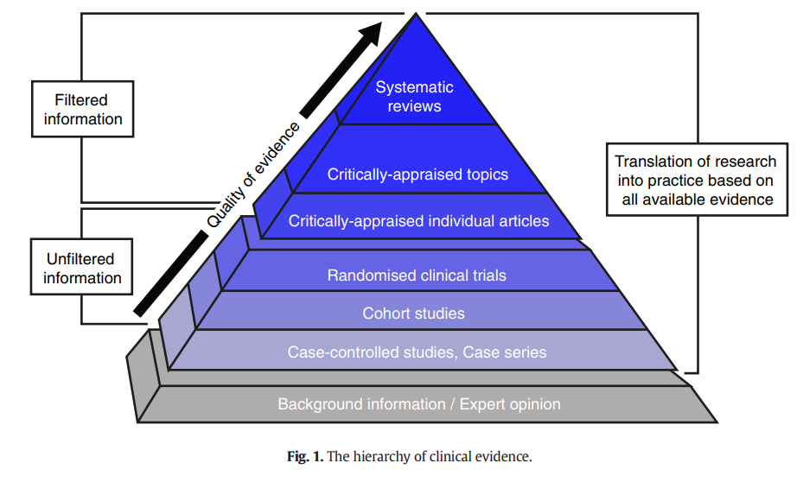
Evidence Based Medecine – What is EBM?
Garatinni S et al. European Journal of Internal Medicine. 2016

Slide 7
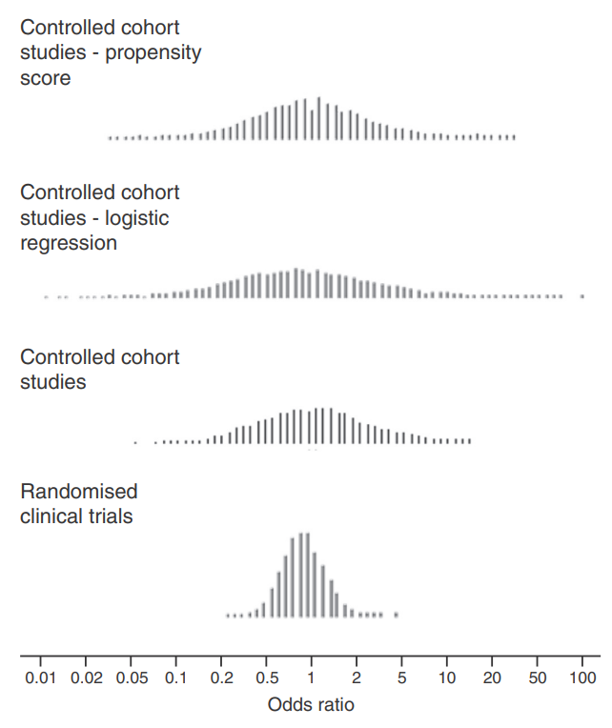
Evidence Based Medecine – What is EBM?
Deeks J et al. Health Technol Assess. 2003

Slide 8
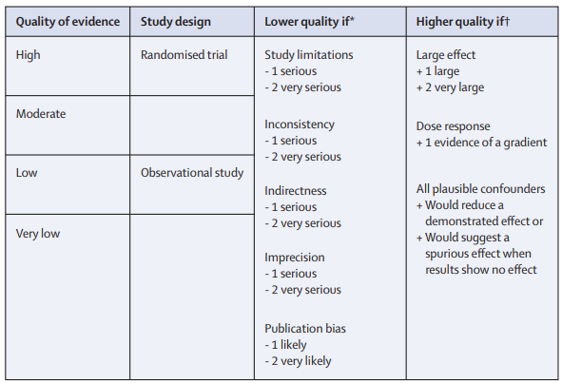
Evidence Based Medecine – What is EBM?
In RCT (oncology) :
. Outcome = survival time with the hazard ratio (HR) as a measure of treatment (so event and no patients).
. Design : decrease type 1 error (false positive conclusion) => significance level to 5% and increase chance (> 90% = power of the study) of rejecting the null hypothesis (true positive conclusion)
What is EBM? | BMJ Best Practice
Djulbegovic B and Guyatt. Lancet. 2017

Slide 9
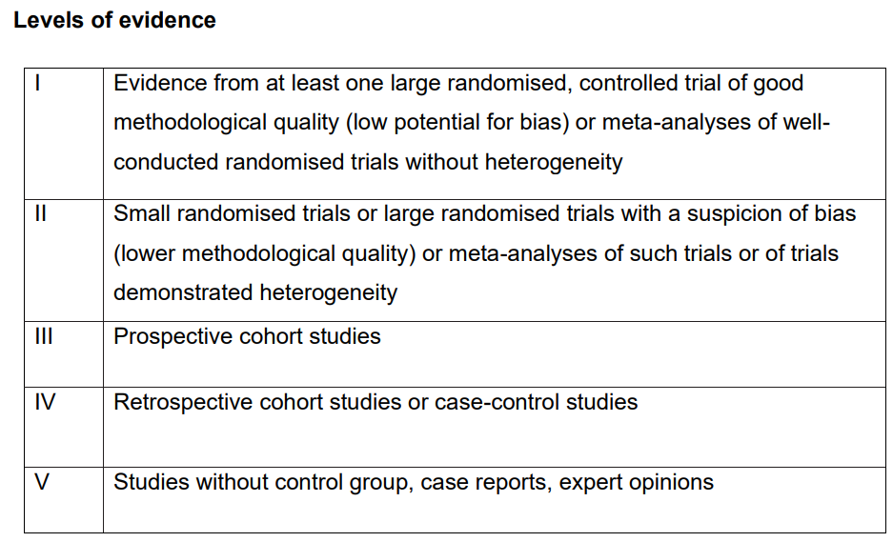
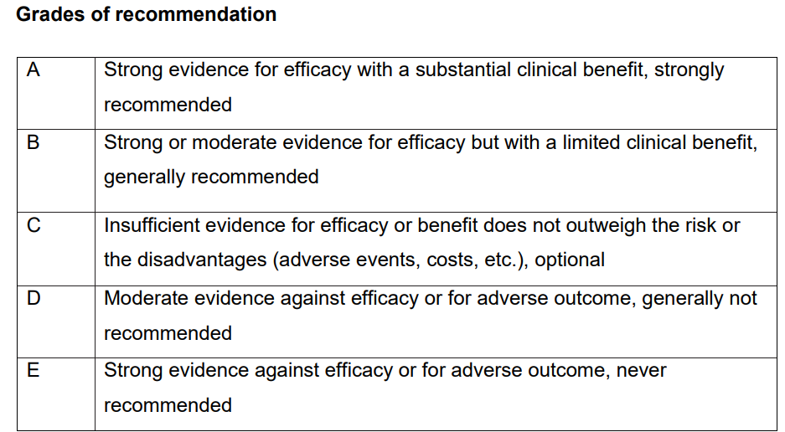
Evidence Based Medecine – What is EBM?
Dykewicz CA. Clin Infect Dis. 2001.
Gross PA et al. Clin Infect Dis. 1994;18(3):421

Slide 10
Evidence Based Medecine – Why?
Medline = 22*10^6 indexed citations from 5600 journals
Each day : > 75 RCTs and >10 systematic reviews…
Haynes and colleagues showed that, with EMB methods, clinicians should be aware of more or less 20 new articles/year to be up to date… And to remain up-to-date in an area of expertise : 50 articles
Standardization of the medicine to improve it (guidelines, …).
“estimates from the US suggest that more than 30% of health care is inappropriate or wasteful; between 70 000 and a third of all deaths occur annually as a result of medical errors; and that only 55% of needed health services are delivered”
Haynes RB et al. JAMA. 2006
Vincent S et al. Cancer Treat Rev. 2005
Makary MA et al . BMJ. 2016.
Djulbegovic B. J Oncol Pract. 2014.

Slide 11
Evidence Based Medecine – Why?
Bias
Designs errors
Abuse of surrogate outcomes, of composite outcomes
Abuse of non-inferiority trials
Abuse of poor reporting or no reporting
Encourages “cookbook medicine” with too much algorithms
Decrease the place of the clinical judgment.
Abuse of the system by parhmaceutic companies
Garattini et al. European Journal of Internal Medicine. 2016
Djulbegovic and Guyatt. Lancet. 2017

Slide 12
What are rare diseases (RDs)?
Definition (EU) : less than 5 patients per 10 000 citizens (> 6000 RDs)
Specific difficulties of this population:
Some have unique molecular characteristics
Complex to give a definition of the disease (i.e. classification of lymphoma)
Complex to diagnose
Bias from “classical” research (i.e. 10% of the authorized products are available through accelerated approval)
Moving from EBM to Personalised Medicine?
Regulation (EC) No 141/2000 of The European Parliament and of The Council of 16 December 1999 on orphan medicinal products. 2000. [cited 2024 April 14]; Available from: http://eur-lex.europa.eu/LexUriServ/ LexUriServ.do?uri=OJ:L:2000:018:0001:0005:en:PDF.
European Medicines Agency. Latest news. 2016. [cited 2024 April 14]; Available from: http://www.ema.europa.eu/. 21
Notes:
Regulation (EC) No 141/2000 of The European Parliament and of The Council of 16 December 1999 on orphan medicinal products. 2000. [cited 2017 November 14]; Available from: http://eur-lex.europa.eu/LexUriServ/ LexUriServ.do?uri=OJ:L:2000:018:0001:0005:en:PDF.
European Medicines Agency. Latest news. 2016. [cited 2017 November 14]; Available from: http://www.ema.europa.eu/. 21. Davis C, Lexchin J, Jefferson T, Gotzsche P, M

Slide 13
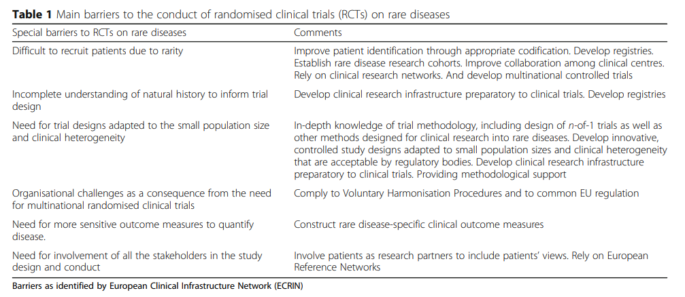
What are rare diseases (RDs)?
Regulation (EC) No 141/2000 of The European Parliament and of The Council of 16 December 1999 on orphan medicinal products. 2000. [cited 2024 April 14]; Available from: http://eur-lex.europa.eu/LexUriServ/ LexUriServ.do?uri=OJ:L:2000:018:0001:0005:en:PDF.
European Medicines Agency. Latest news. 2016. [cited 2024 April 14]; Available from: http://www.ema.europa.eu/. 21
Notes:
Regulation (EC) No 141/2000 of The European Parliament and of The Council of 16 December 1999 on orphan medicinal products. 2000. [cited 2017 November 14]; Available from: http://eur-lex.europa.eu/LexUriServ/ LexUriServ.do?uri=OJ:L:2000:018:0001:0005:en:PDF.
European Medicines Agency. Latest news. 2016. [cited 2017 November 14]; Available from: http://www.ema.europa.eu/. 21. Davis C, Lexchin J, Jefferson T, Gotzsche P, M

Slide 14
How can we mix RDs and EBM?
COVID crisis teached us a lot! In one year, we discovered the pathology, physiopathology and we developed several treatments (from new generation of vaccine to monoclonal antibodies).
Efficacity
New ways to conduct clinical research
Accelerated approvment
Large consortium
Notes:
Regulation (EC) No 141/2000 of The European Parliament and of The Council of 16 December 1999 on orphan medicinal products. 2000. [cited 2017 November 14]; Available from: http://eur-lex.europa.eu/LexUriServ/ LexUriServ.do?uri=OJ:L:2000:018:0001:0005:en:PDF.
European Medicines Agency. Latest news. 2016. [cited 2017 November 14]; Available from: http://www.ema.europa.eu/. 21. Davis C, Lexchin J, Jefferson T, Gotzsche P, M

Slide 15
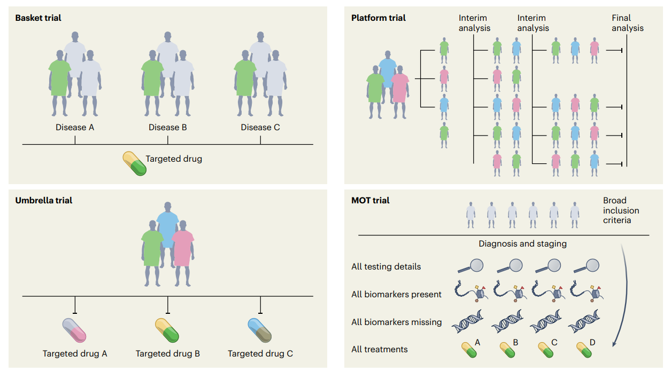
A) ‘Master’ Protocols
Subbiah V. Nature Med. 2022

Slide 16
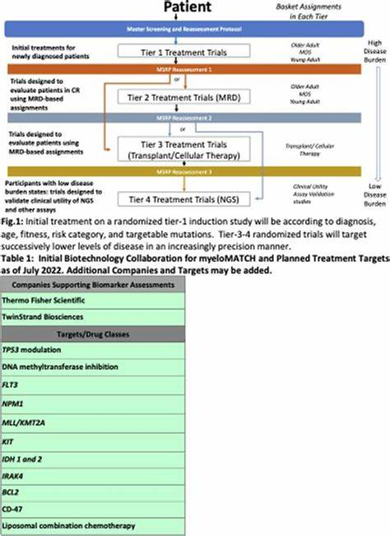
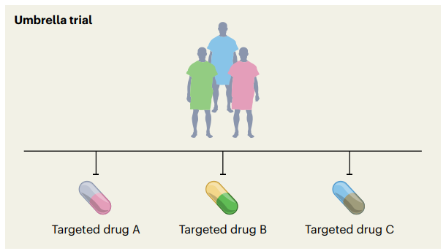
A) ‘Master’ Protocols
Umbrella Trial : evaluation of multiple targeted therapies (A, B and C) for the same disease entity, stratified by molecular alteration (rose for A, green for B and blue for C).
Subbiah V. Nature Med. 2022
Little R. myeloMATCH. Blood. 2022
Notes:
Subbiah V. Nature Med. 2022
Little R. myeloMATCH. Blood. 2022

Slide 17
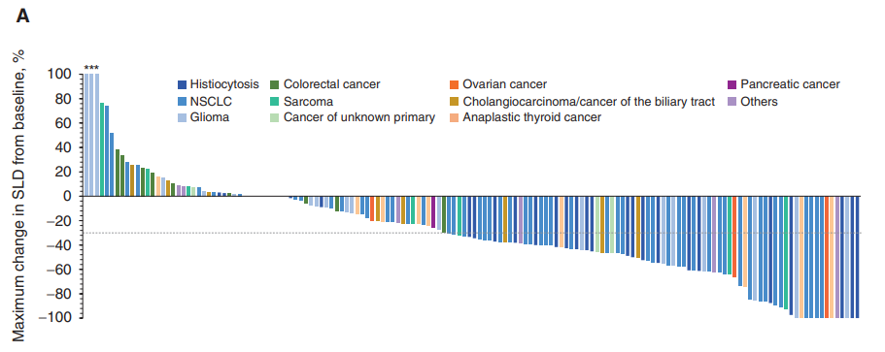
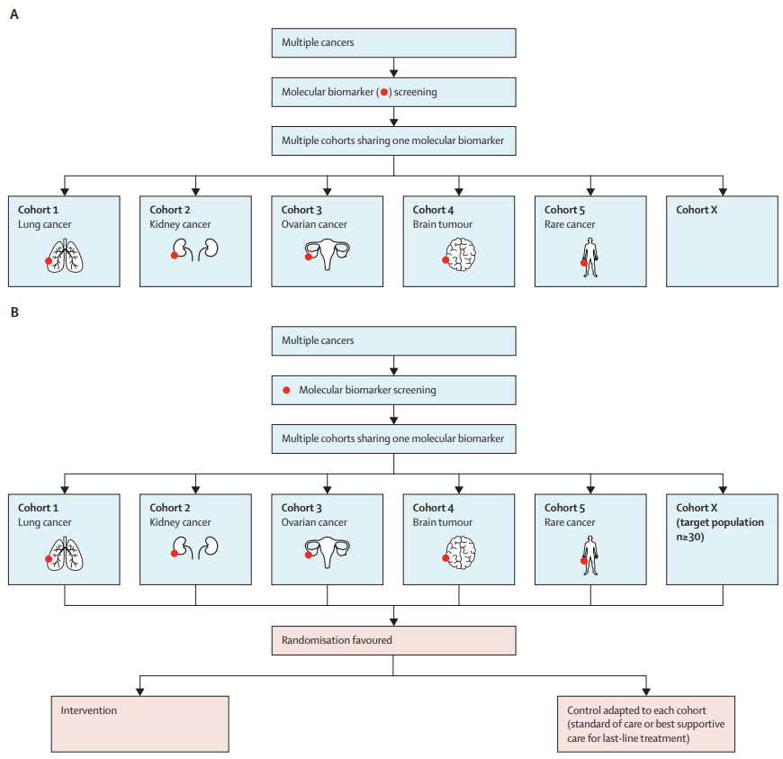
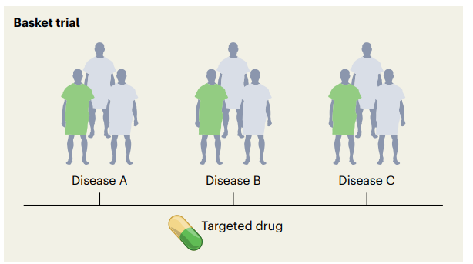
A) ‘Master’ Protocols
Basket trial : we focused on the same underlying molecular aberration without separation from the tissue of origin
Subbiah V et al. Cancer discovery. 2020
Lengliné E et al. Lancet Oncol. 2021

Slide 18
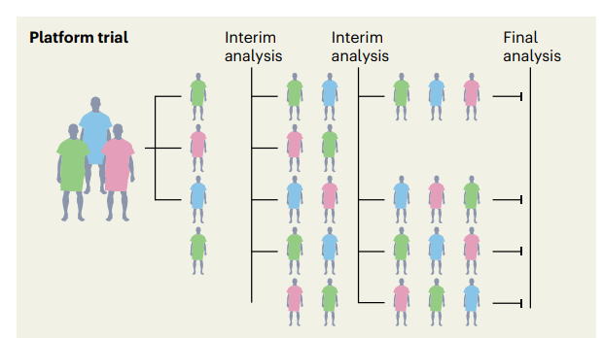
A) ‘Master’ Protocols
Platform trial : multi-arm with multi-stages which compare several group with the SAME control group
Normand, S.-L. T. NEJM. 2020.)

Slide 19
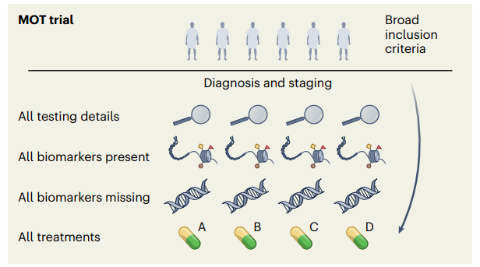
A) ‘Master’ Protocols
Master Observational Trial : prospective, observational study that collect broadly biomarker and data on each participant. It combines master interventional trial and prospective trial.
GOAL : improve the collection and quality of Real World Data
Subbiah V. Nature Med. 2022

Slide 20
B) Adapted clinical data
Using “new” control group
retrospective chart of RWD (NCT04285723)
Synthetic control arms (derived from RWD) (ARROW Study in lung cancer, SPRINT trial in neurofibroma)
N-of-1 trial : single patient clinical trial (i.e. Castleman disease and IL-6 blockade refractory)
Fajgenbaum, D. C. et al. J. Clin. Investig. 2019
Notes:
Fajgenbaum, D. C. et al. J. Clin. Investig. 2019

Slide 21
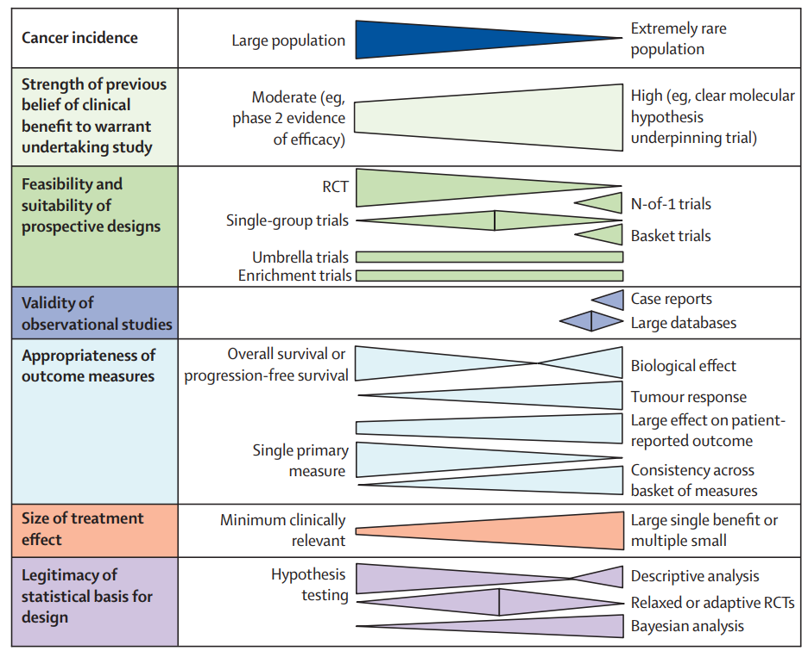
From EBM to Personalized Medicine for RDs
Billingham L et al. Lancet Oncol. 2016
Notes:
Fajgenbaum, D. C. et al. J. Clin. Investig. 2019

Slide 22
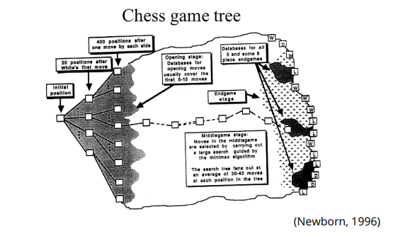
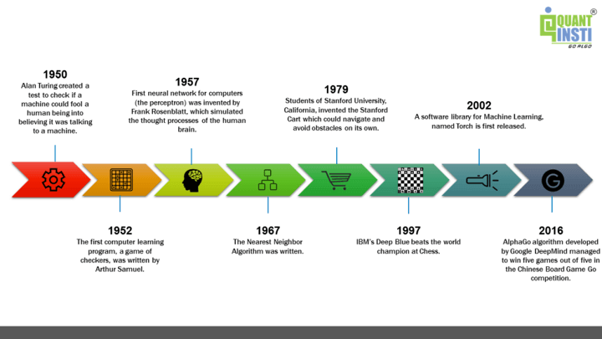
Artificial Intelligence

Slide 23
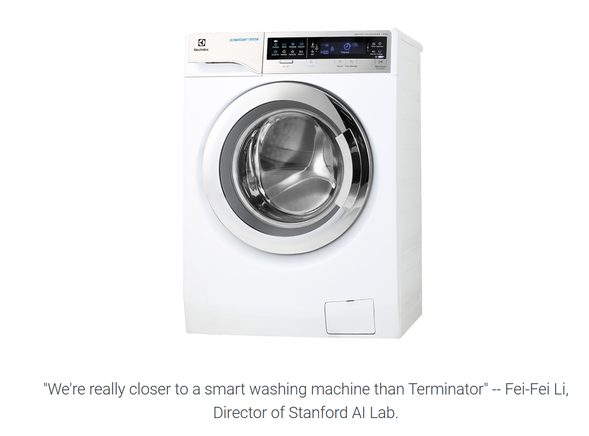
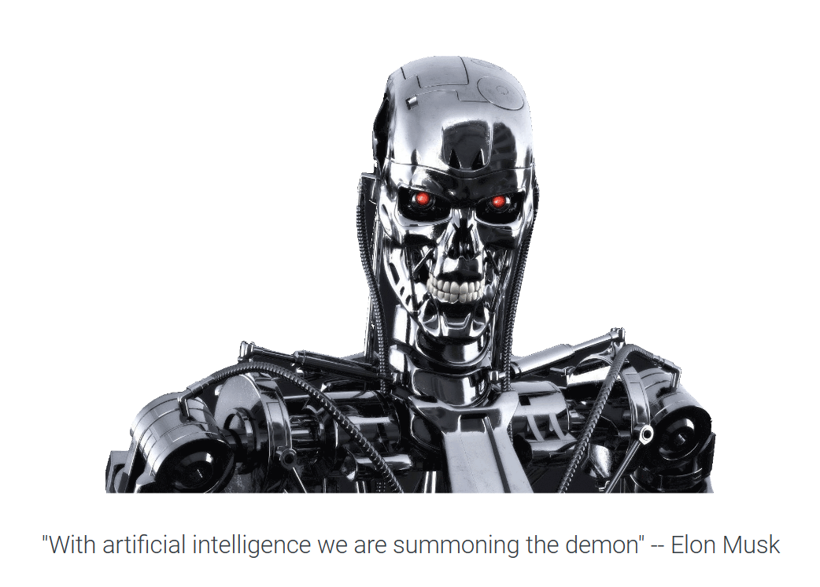
What is AI?

Slide 24
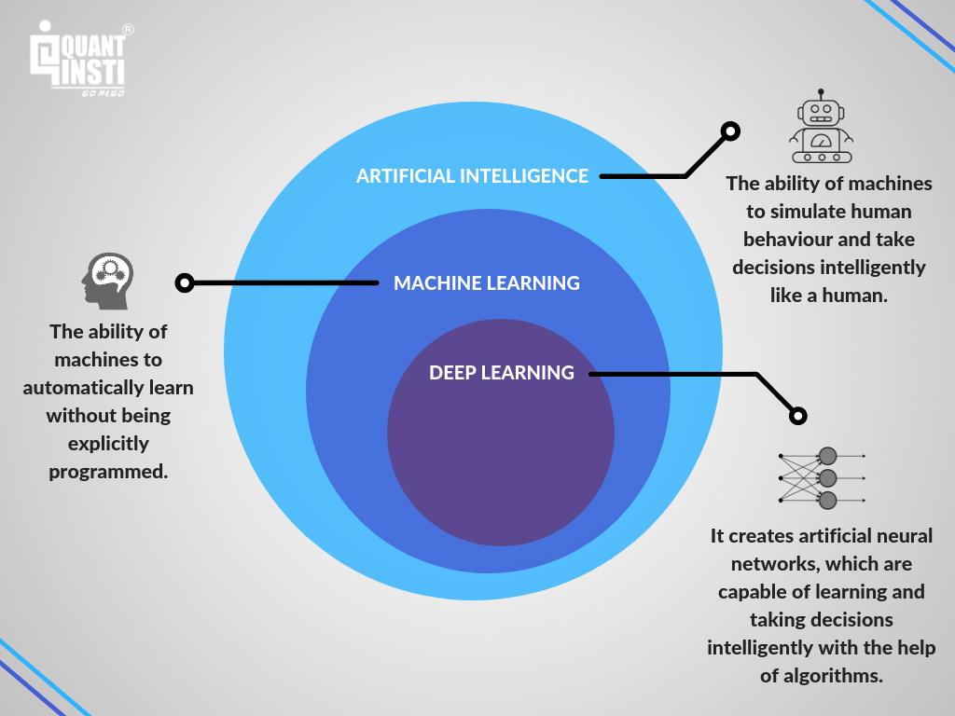
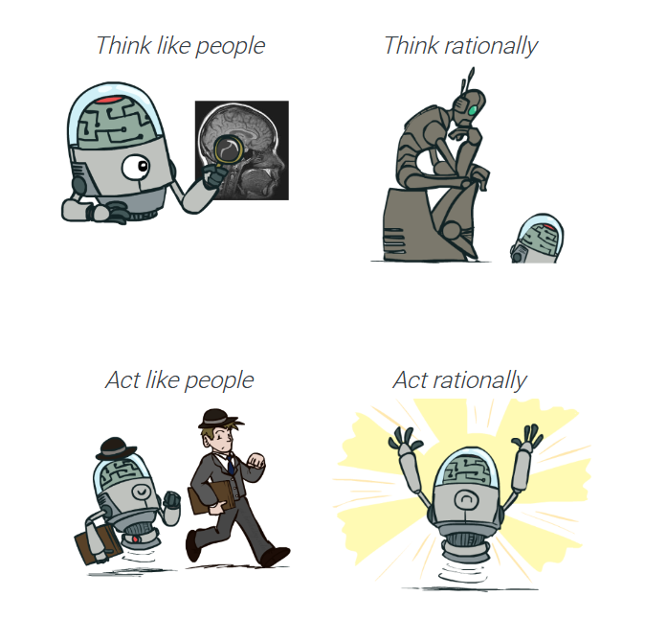
What is (Artificial) Intelligence?
Image credits : CS188, UC Berkeley

Slide 25
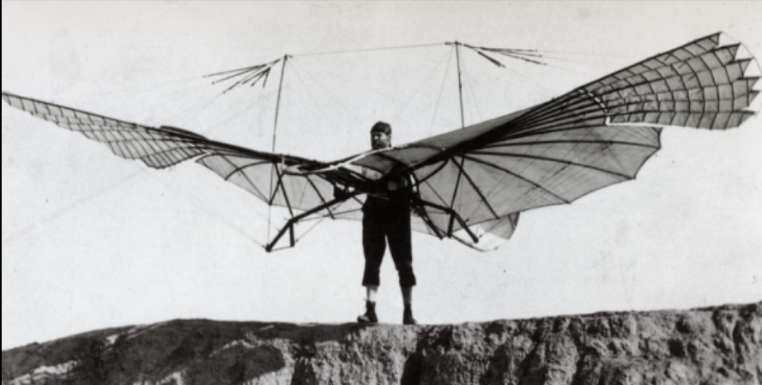
What is (Artificial) Intelligence?
Aeronautics is not defined as the field of making machines that fly so exactly like pigeons that they can fool even other pigeons.

Slide 26
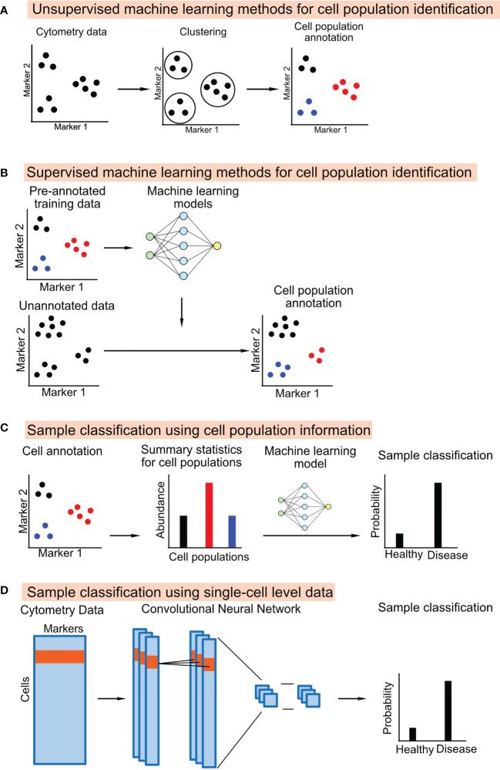
What is AI?
Hu Z et al. Front Immunol 2021
Notes:
Hu Z et al. Front Immunol 2021

Slide 27
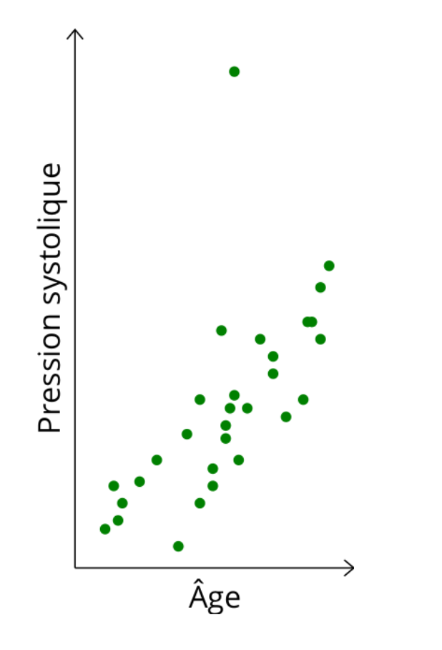
How it works?
You want to predict some variable (output) from initial variable (input)
Credits: François Fleuret, 2023.
Notes:
Hu Z et al. Front Immunol 2021

Slide 28
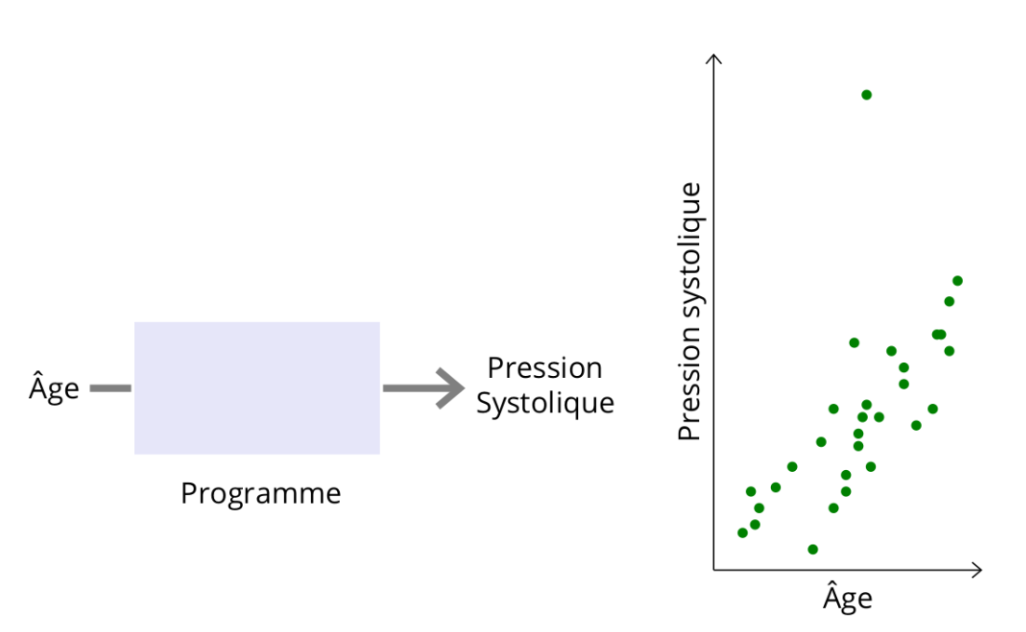
How it works?
Credits: François Fleuret, 2023.
Notes:
Hu Z et al. Front Immunol 2021

Slide 29
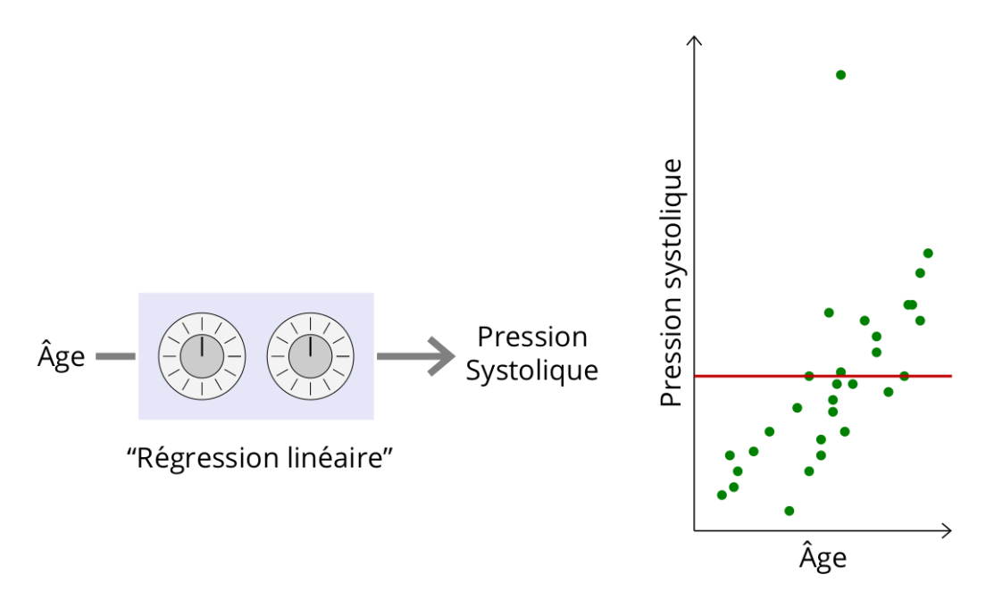
How it works?
Credits: François Fleuret, 2023.
Notes:
Hu Z et al. Front Immunol 2021

Slide 30
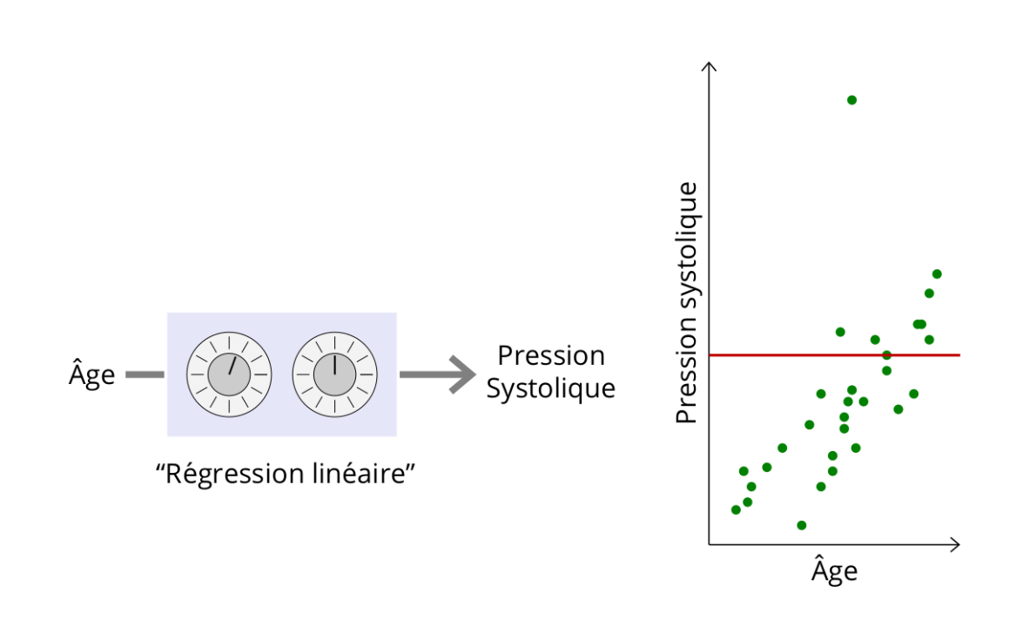
How it works?
Credits: François Fleuret, 2023.
Notes:
Hu Z et al. Front Immunol 2021

Slide 31
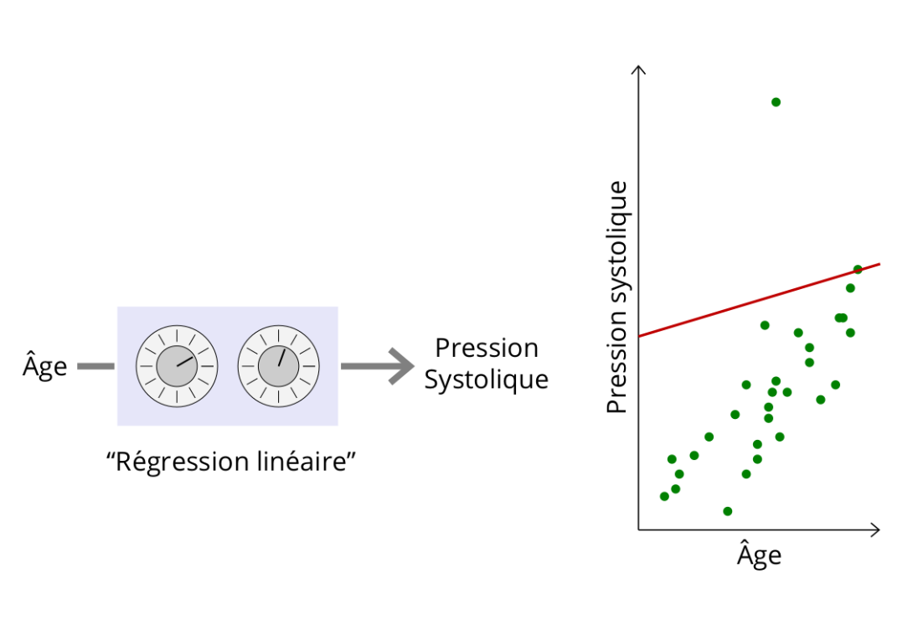
How it works?
Credits: François Fleuret, 2023.
Notes:
Hu Z et al. Front Immunol 2021

Slide 32
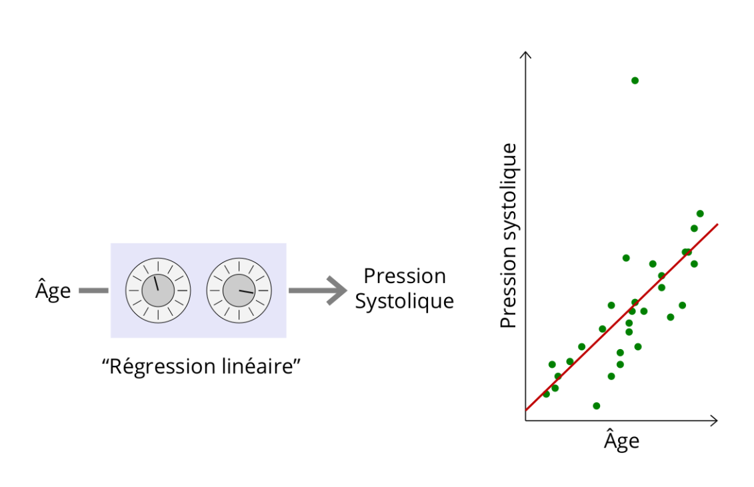
How it works?
Credits: François Fleuret, 2023.
Notes:
Hu Z et al. Front Immunol 2021

Slide 33
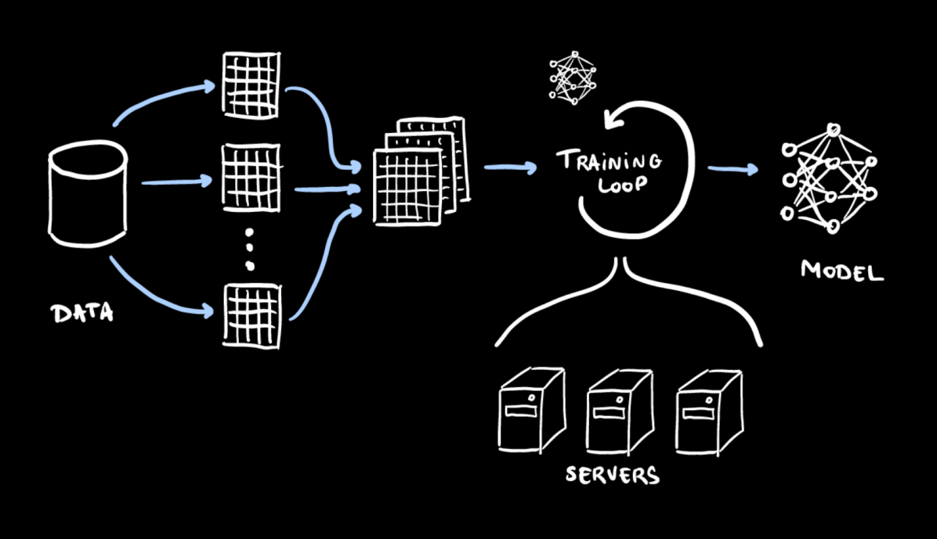
How it works? More schematic…
Credits: Gilles LOUPPE, 2021.
Notes:
Hu Z et al. Front Immunol 2021

Slide 34
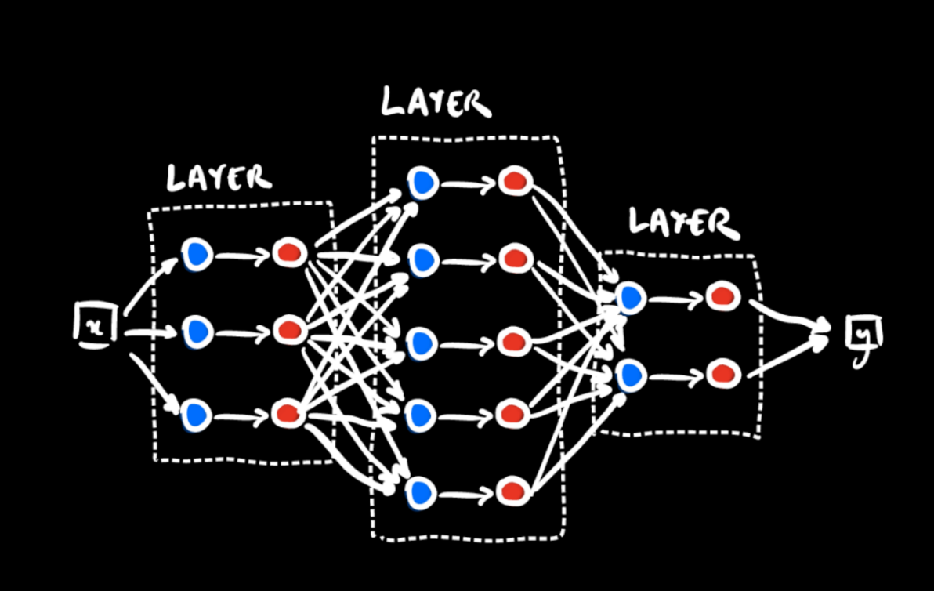
How it works? More schematic…
INPUT LAYER
OUTPUT LAYER
Credits: Gilles LOUPPE, 2021.
HIDDEN LAYERS
Notes:
Hu Z et al. Front Immunol 2021

Slide 35
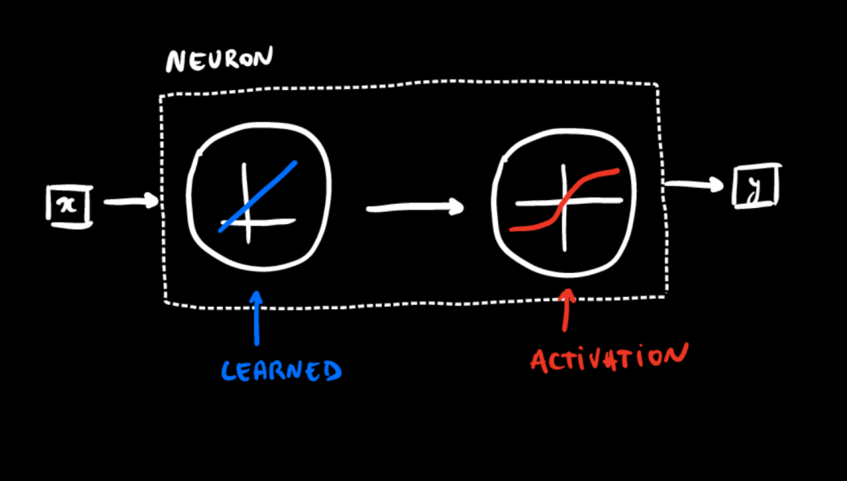
How it works? More schematic…
Each neuron take the input ‘x’ from previous layers using various weights= parameters for learning (determined by training in a second time)
Activation of the neuron in the next layer =
Sum of the weight * activation of the previous layer
Activation function act on the sum of weight in the neuron by passing it through a function. It decides if that neuron should propagate its information or not to the next layer
Credits: Gilles LOUPPE, 2021.
Notes:
Hu Z et al. Front Immunol 2021

Slide 36
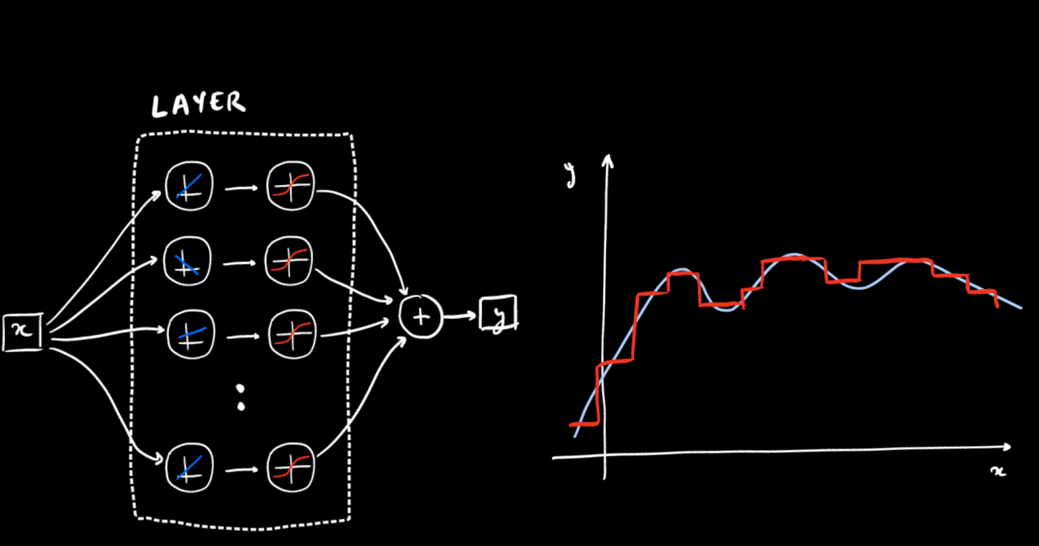
How it works? More schematic…
Credits: Gilles LOUPPE, 2021.
Notes:
Hu Z et al. Front Immunol 2021

Slide 37
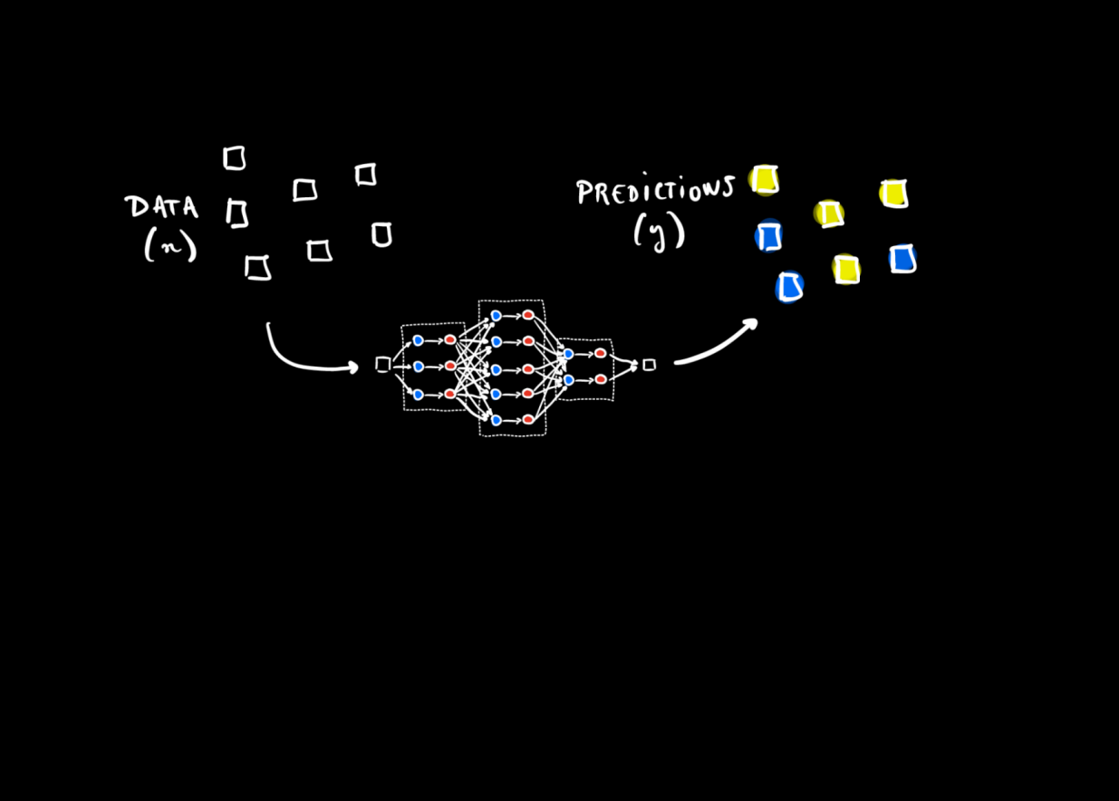
How it works? More schematic…
Forward propagation
Loss function means how good is the model to really predict the truth. During the training we want to decrease the loss as much as possible.
Credits: Gilles LOUPPE, 2021.
Notes:
Hu Z et al. Front Immunol 2021

Slide 38
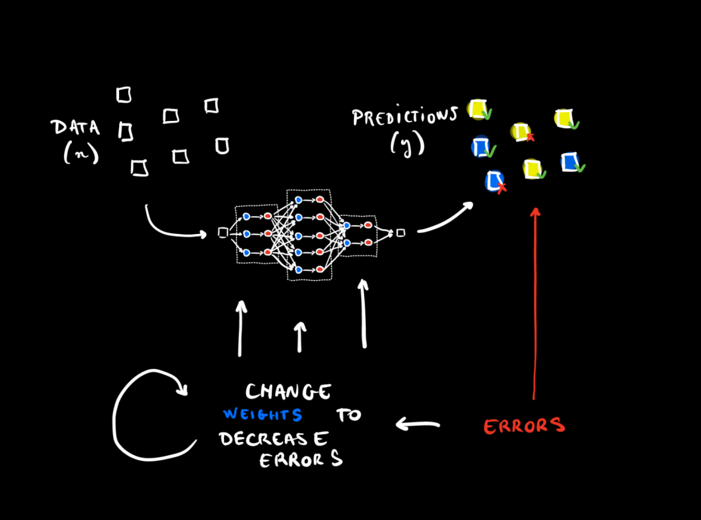
How it works? More schematic…
Back propagation
Credits: Gilles LOUPPE, 2021.
Notes:
Comput the loss function at the output layer by comparing the predicted output ‘y’ with the actual output from the dataset (often gradient descent which compute the way where the errors are smaller when you change parameters ‘weight’)

Slide 39
How it works? More intuitive…
Demo-Site :
https://www.deeplearning.ai/ai-notes/initialization/index.html

Slide 40
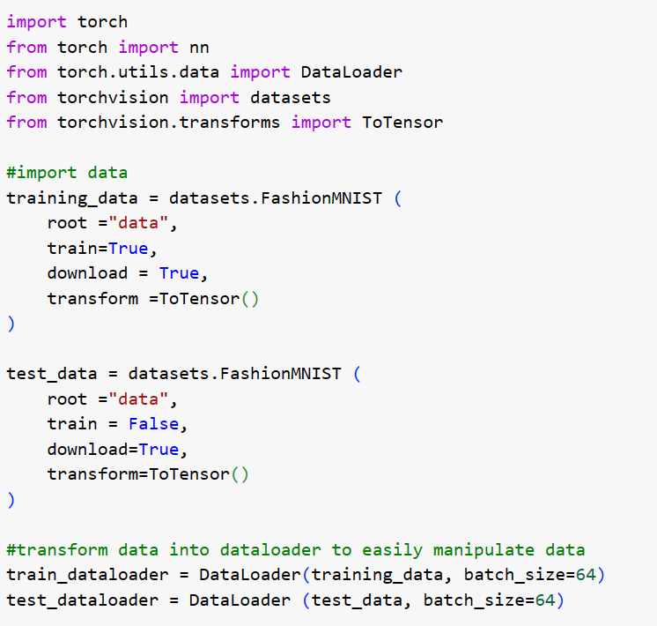
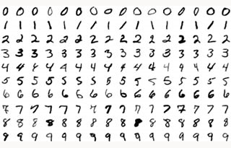
How it works? In reality

Slide 41
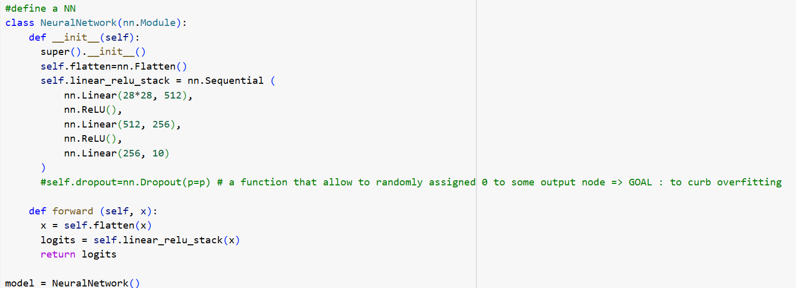
How it works? In reality

Slide 42
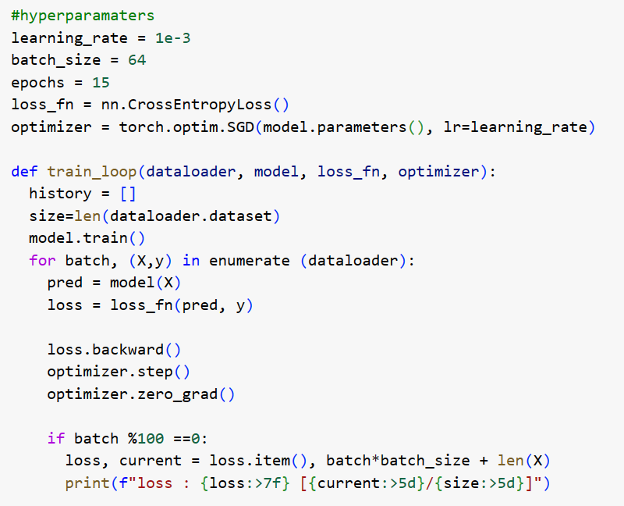
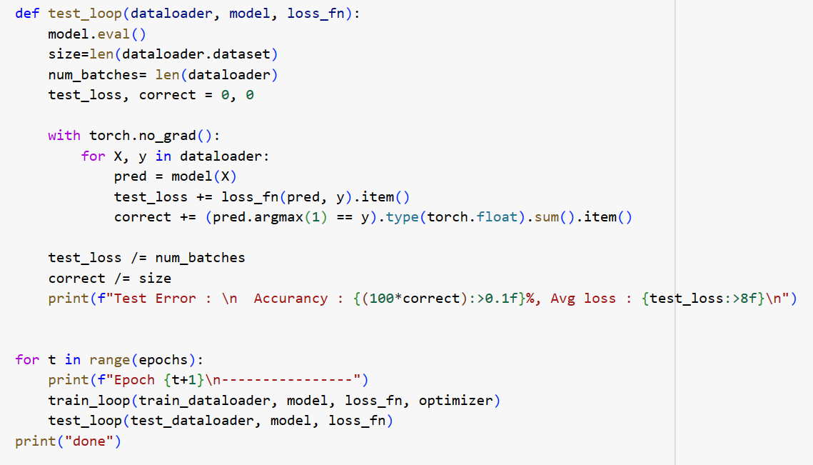
How it works? In reality

Slide 43
How it works? In reality

Slide 44
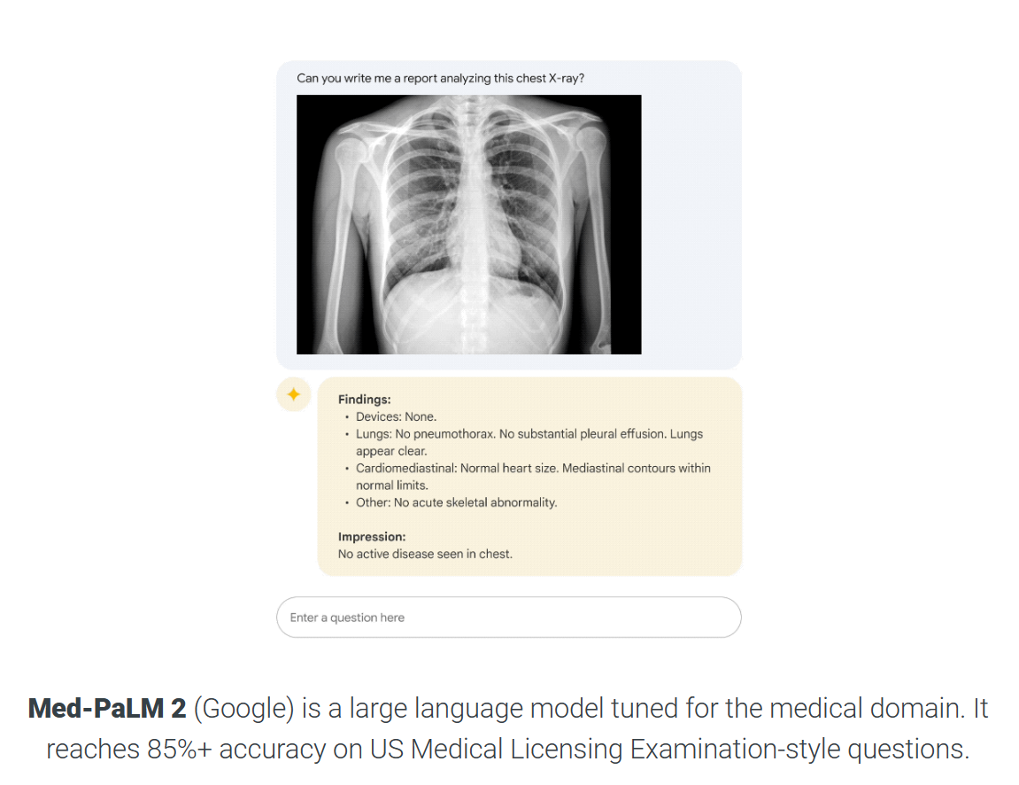
Few applications in the medical fields
Singhal K et al. Nature. 2023

Slide 45
Few applications in the medical fields

Slide 46
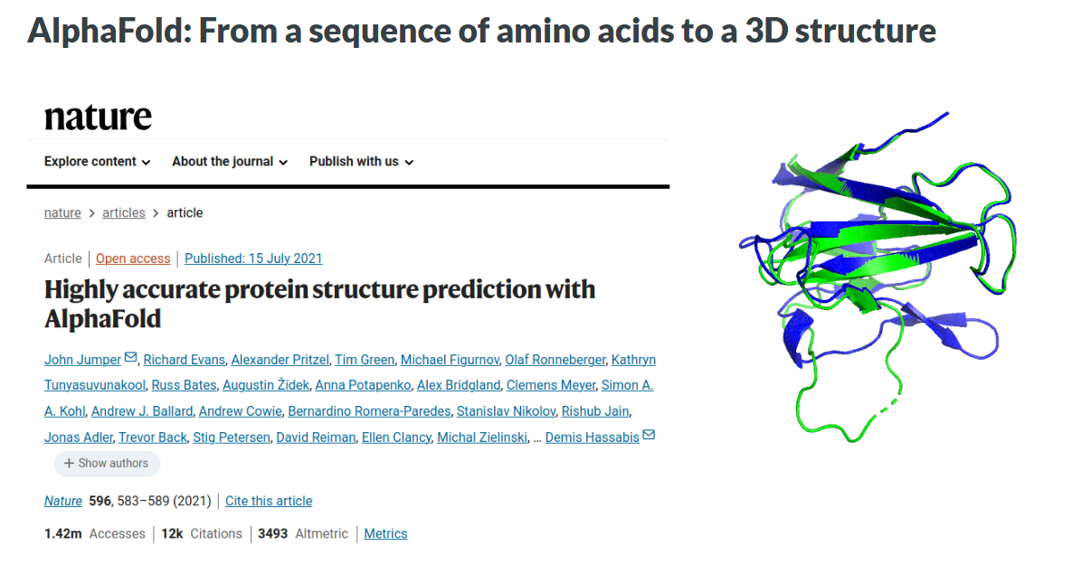
And thinks that is impossible for us…

Slide 47
Limitations
Good model and training depend of the quality and quantity of the data.
Required ressource to train and run them can be prohibitive.
Neural networks are composed of black boxes (how certains boxe are currently working is poorly understood and how they predict (good or not) are very difficult to explain
Certifying the robustness of NN is challenging. So how to use it in safety-critical situation like medicine? Who will be responsible if the prediction is wrong?

Slide 48
Thank you for your attention!

Slide 49
Recommend lectures
Basic Statistic and critical interpretation
(BOOK) Intuitive Biostatistics Motulsky (free pdf)
Previous BHS lesson from KM Wissing about EBM and critical interpretation
Evidence-based medicine
- Garatinni S et al. European Joural of Internal Medicine. 2016
- Djulbegovic and Guyatt. Lancet. 2017
Evidence-based medicine and rare diseases
Subbiah V. Nature Med. 2023
Billingham L et al. Lancet Oncol. 2016
Artificial intelligence
The Little Book of Deep Learning (fleuret.org)
Neural networks and deep learning

