Slide 1
Geriatrics in haematology
Prof. Dr. A.Velghe
20/04/2024

Slide 2
What are we talking about?
Concept of frailty
Assessment of frailty
Comprehensive geriatric assessment (CGA)
Available evidence in haematology
From theory to practice
Let’s focus on some details
Take home messages

Slide 3
Concept of frailty

Slide 4
Concept of frailty
Frailty reflects a state of increased vulnerability to adverse health outcomes for individuals of the same chronological age
“Dynamic process”
Gandolfini et al. Front Nutr 2019; 6: 169
Notes:
The cycle of frailty. The four key factors of frailty (in the central circle) are sarcopenia, lower resting metabolic rate, lower energy expenditure, and chronic undernutrition. These factors are interconnected and amplifying the process and it is hard to distinguish the first factor that started it. In the peripheral area are represented the contributors to these factors. Sarcopenia itself, through the reduction of muscle strength and power, provokes one of the key features of the frailty assessment: the reduced walking speed. The diaphragm and visceral muscle sarcopenia along with anemia are responsible for reduced oxygen uptake (VO 2 ) and subsequent exhaustion, which contribute in slowing the walking speed. . In some cases, the marked reduced walking capacity can configure a disability with eventually loss of independency and need for assistance.
The main contributors to sarcopenia are weight loss (through protein and micronutrient deficit and increased catabolism), musculoskeletal senescence and various diseases. Reduced walking speed is associated with lower physical activity and subsequent lower energy expenditureNeuroendocrine dysregulation, frequently observed in older people, can reduce the appetite (anorexia of aging) and contribute to chronic undernutrition along with the lower energy expenditure with subsequent weight loss. A mild and chronic inflammation can have a negative impact in these processes. VO 2 , oxygen uptake.

Slide 5
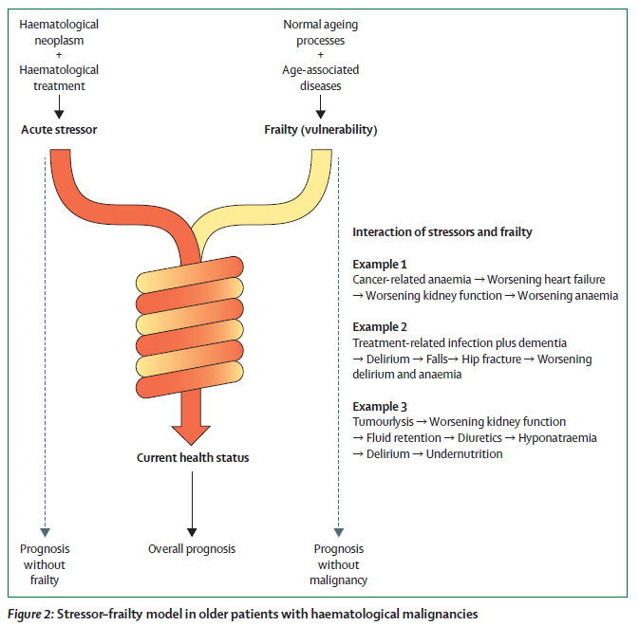
Concept of frailty
Goede et al. Lancet Healthy Longev 2021; 2: e736-45
Notes:
On top of this physiological organ senescence due to ageing comes pathological organ dysfunction due to chronic illnesses with inherent polypharmacy. Together, these elements determine an individual’s existing frailty background (fit, prefrail, frail). At the time of the clinical manifestation of a haematological disease, typical conditions that emerge from the new illness (or perhaps from starting a treatment) add to an individual’s existing frailty status and contribute to a frailty build-up (figure 1). Phenomena can stimulate or exacerbate a frailty phenotype by directly causing weakness, exhaustion, and low functional performance in people with haematological malignancies.
These include cancer or treatment-related cytopenia, immunosuppression, infection, and organ infiltration or damage. Important to remember is the fact that this should not be seen as simply the sum of several conditions but haematological stressors and underlying frailty do interact
The occurrence of such conditions increases the number of accumulated deficits. Furthermore,
According to clinical experience, it is not simply the sum of several conditions, but rather complex bidirectional interactions arising from the co-incidence of haematological stressors and underlying frailty that ultimately will dictate a patient’s health status and general vulnerability at a given point of time. Examples of such interactions are shown in figure 2. Under this model, the overall prognosis of older people with haematological neoplasms will be determined by their current health status, whereas an isolated consideration of the malignancy or the pre-existing frailty allows a theoretical
Frailty is not an “all or none,” it is a dynamic process [18]. Although it is important to identify and categorize those who are frail, identifying those at risk of becoming frail [19] is equally important. A person in a pre-frail state is characterized as having a health state that is not robust, and not yet frail, but predisposed to becoming frail [8]. Pre-frailty is therefore a critical period, as interventions implemented during the pre-frail period have been shown to postpone decline into a frail state [20, 21]. Thus, a continuum exists with those who are robust, pre-frail, and those who are experiencing frailty at different levels of severity causing varying levels of dependence [22].

Slide 6
Assessment of frailty

Slide 7
Frailty assessment
At least 29 different frailty instruments available to date
Considerable variability in quality
Considerable variability in frailty labeling
Fried frailty criteria and Rockwood Frailty Index are considered gold standards
Dent et al. Eur j int med 2016

Slide 8
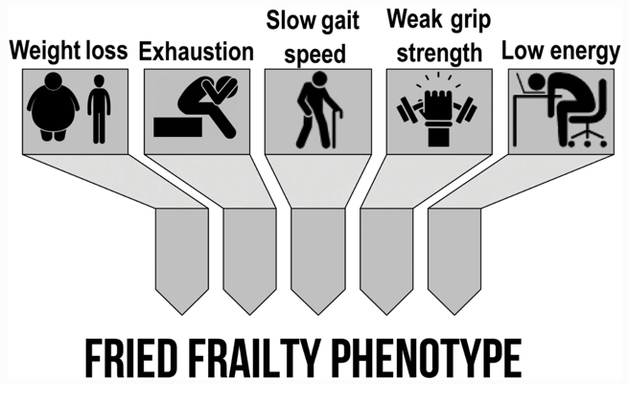
Fried frailty criteria
Capurso et al. Nutrients 2020; 12(1): 35
Salaffi et al. Clin Rev Allergy Immunol 2023; 64(2): 206-221
Notes:
At the operational level there are 2 gold standards to identify frailty in older people: the Fried frailty criteria, based on a phenotype model, and the Rockwood frailty index, based on a deficit-accumulation model.
Frailty is best understood as a state [8, 9] wherein older people experience increased vulnerability related to decline in function and reserve across multiple organ systems [10]. A consensus statement specifically on physical frailty characterizes it as: “a medical syndrome with multiple causes and contributors characterized by diminished strength, endurance, and reduced physiologic function that increases an individual’s vulnerability for developing increased dependency and/or death” [11]. Two complementary definitions with accompanying assessments include: the (1) the frailty phenotype; and (2) the frailty index (Fig. 1.1). First, Fried’s frailty phenotype classifies frailty as a biologically driven syndrome of accumulated declines across multiple systems. This characterization of frailty includes several symptoms, such as weakness, low energy, slow walking speed, low physical activity, and weight loss [12]. Second, Rockwood and colleagues define frailty as a deficit-driven state [13,14,15]. This is operationalized through the frailty index wherein the greater the number and nature of aggregate health deficits an individual has, the greater the level of frailty [16, 17]. These conceptualizations see frailty as both an etiology and an outcome of accumulated deficits, respectively.

Slide 9
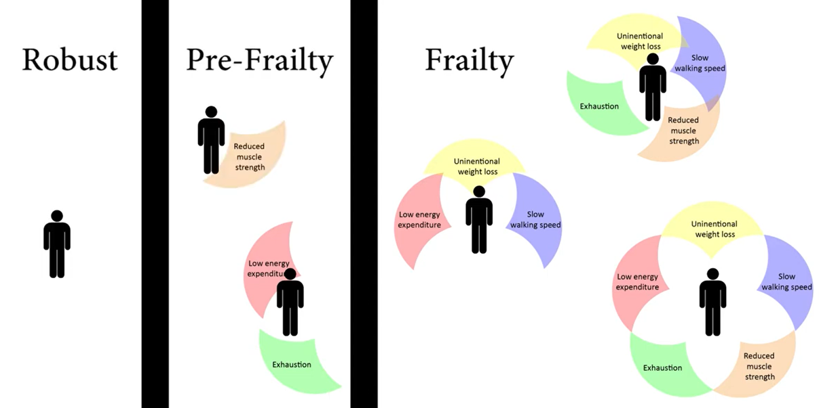
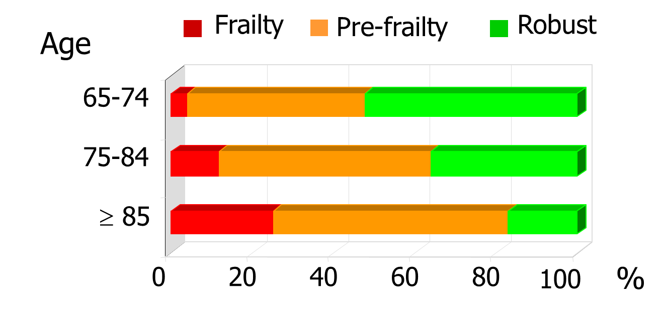
Fried frailty criteria
Fried LP et al J Gerontol, 2001
Notes:
Frailty is a dynamic process. Although it is important to identify and categorize those who are frail, identifying those at risk of becoming frail [19] is equally important. A person in a pre-frail state is characterized as having a health state that is not robust, and not yet frail, but predisposed to becoming frail [8]. Pre-frailty is therefore a critical period, as interventions implemented during the pre-frail period have been shown to postpone decline into a frail state [20, 21]. Thus, a continuum exists with those who are robust, pre-frail, and those who are experiencing frailty at different levels of severity causing varying levels of dependence [22].
Frailty is best understood as a state [8, 9] wherein older people experience increased vulnerability related to decline in function and reserve across multiple organ systems [10]. A consensus statement specifically on physical frailty characterizes it as: “a medical syndrome with multiple causes and contributors characterized by diminished strength, endurance, and reduced physiologic function that increases an individual’s vulnerability for developing increased dependency and/or death” [11]. Two complementary definitions with accompanying assessments include: the (1) the frailty phenotype; and (2) the frailty index (Fig. 1.1). First, Fried’s frailty phenotype classifies frailty as a biologically driven syndrome of accumulated declines across multiple systems. This characterization of frailty includes several symptoms, such as weakness, low energy, slow walking speed, low physical activity, and weight loss [12]. Second, Rockwood and colleagues define frailty as a deficit-driven state [13,14,15]. This is operationalized through the frailty index wherein the greater the number and nature of aggregate health deficits an individual has, the greater the level of frailty [16, 17]. These conceptualizations see frailty as both an etiology and an outcome of accumulated deficits, respectively.

Slide 10
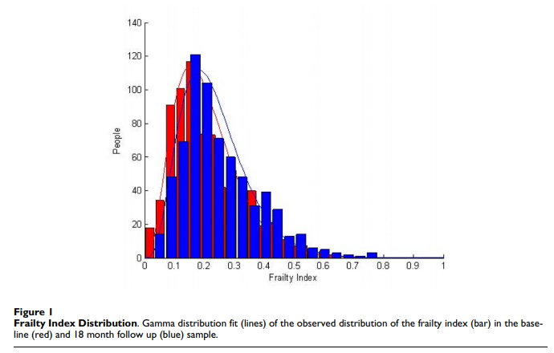
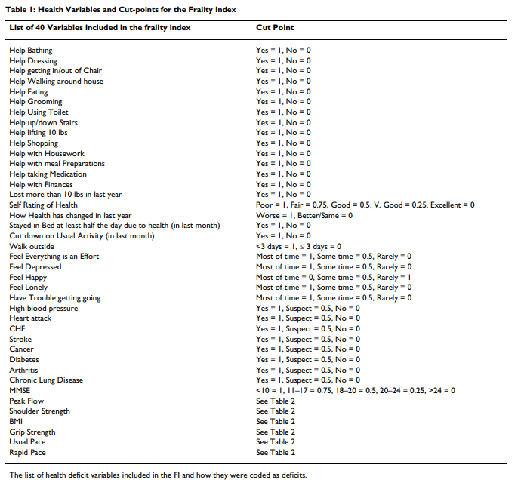
Rockwood frailty index
The Frailty index is defined as the proportion of deficits present in an individual out of the total number of age-related health variables considered.
The value 0.2 on the frailty index is recognized by multiple frailty measures as approaching a frail state.
In a study that related the frailty index approach to the phenotypic definition of frailty (Fried), 0.2 corresponded to the mean frailty index value for persons defined as "pre-frail".
BMC Geriatrics 2008; 8:24
Searle et al. BMC Geriatrics 2008; 8: 24
Notes:
The value 0.2 on the frailty index is recognized by multiple frailty measures as approaching a frail state [7, 8, 22], so that this method met the convention of defining deficit cut-points. In addition, setting the value at, say, 0.3 seems unreasonably high, as this is consistently well into the range of frailty, however, defined (including by an increased hazard) so would be insensitive. Greater sensitivity is obtained at a cut-point of 0.1, but with less specificity.

Slide 11
Frailty assessment in haematology
Embedded in a CGA in one way or another
No large studies have investigated Fried or Rockwood in patients with haematological malignancies
Difficult to implement in clinical practice
A few other assessment methods have been suggested
Comorbidity scores, frailty screening and geriatric assessment most common
Mostly single domain
Small to moderate size, retrospective
Specific malignancy vs heterogeneous patient population
Goede et al. Lancet Healthy Longev 2021; 2: e736-45
Notes:
To date, no large studies have investigated Fried frailty phenotype criteria or the Rockwood frailty index in people with haematological malignancies. Although these are considered gold standard techniques to capture frailty, these methods are difficult to implement in clinical practice and, therefore, are rarely used in routine care. In the case of myeloma, efforts were made to develop a deficit-accumulation frailty index using a multi-item scale, but these have remained experimental. A few assessment methods other than Fried phenotype criteria or the frailty index by Rockwood, have been suggested for evaluating fitness and vulnerability in older people with haematological malignancies. Among these, comorbidity scores, frailty screening, and geriatric assessment are the most common. Notably, most of the studies devoted to examining such approaches in haematological cancer were of small to moderate size and of retrospective nature. Although some of these studies focused on a specific malignancy (eg, acute myeloid leukaemia or multiple myeloma), others included more heterogenous patient populations with a breadth of haematological entities. Key features and potential areas of application of the presented tools or scales are outlined in tables 2 and 3.

Slide 12
Comprehensive geriatric assessment

Slide 13
Comprehensive geriatric assessment
A CGA is a multidimensional interdisciplinary diagnostic process
focused on determining a frail older person’s medical, psychological, and functional capability
in order to develop a coordinated and integrated plan for treatment and long-term follow-up.
Rubenstein LZ. Springer 1195
Lipschitz S. Coninuing Medical Education 2007; 25(9): 418-420
Notes:
Hoe wordt de fysiologische leeftijd van een individu nu bepaald? Binnen geriatrie maken we hierbij gebruik van het geriatrisch bilan of het comprehensive geriatric assessment, kortweg CGA genoemd. Een CGA is een multidisciplinaire evaluatie, waarbij niet alleen het medische, maar ook psychische, functionele en sociale elementen worden bekeken.

Slide 14
Comprehensive geriatric assessment
Cognition
Functionality
Vision
and hearing
Items that matter for a patient
Social
Mobility
and
falls
Mood
Comorbidity
Nutrition
Polypharmacy
Notes:
Geriatric assessment includes a thorogh examinatio of individual frailty domains using separate instruments. Therefore, geriatric assessment outputs values for each frailty domain rather than a single value across domains.
Notably, the acuity of the haematological illness of the patient can have a major effect on geriatric assessment results obtained with such tools. For example, in patients with poor current health status due to haematological cancer, geriatric assessment results might indicate that the cancer is highly pathological, although otherwise no higher-grade frailty background is present. Comparison with the previous
functional situation, therefore, is required for proper interpretation of geriatric assessment results.

Slide 15
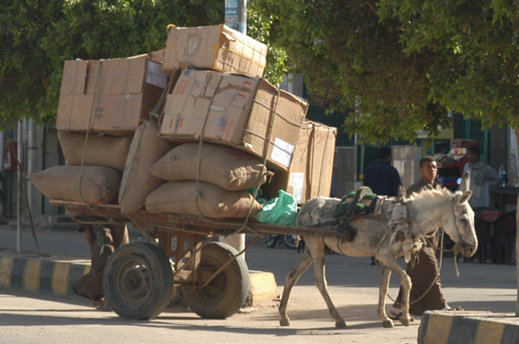
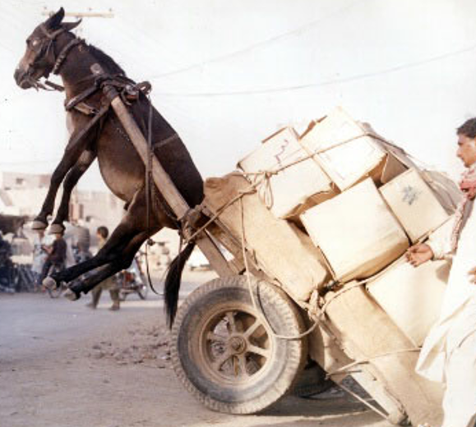
Comprehensive geriatric assessment
CGA
fit
unfit
frail
Notes:
De informatie die we verzamelen door middel van het assessment moet ons toelaten patiënten op te delen in drie groepen, met duidelijke verschillen in functionele reserves en residuele levensverwachting. In dit proefschrift wordt onze populatie opgedeeld in fitte individuen, niet-fitte individuen en fraile of kwetsbare individuen.

Slide 16
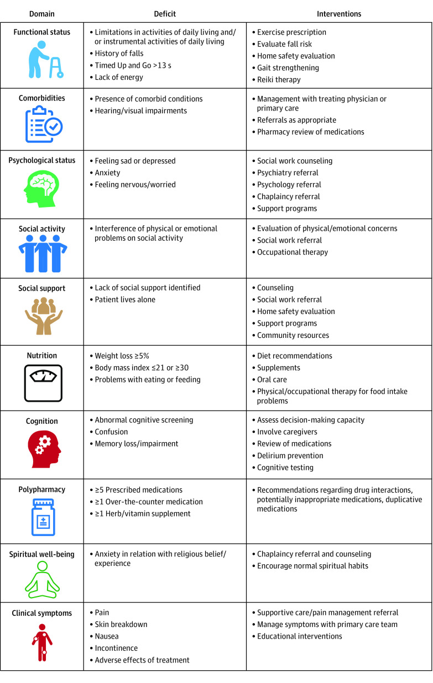
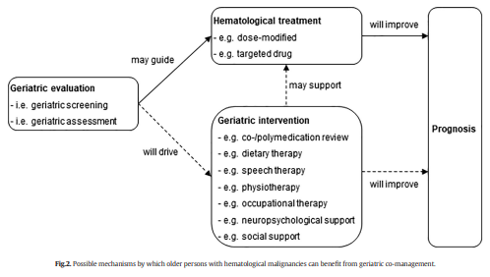
Li et al. JAMA Oncology 2021; (7(11): e214158
Goede et al. J Ger Oncol 2019; 10: 497-503

Slide 17
SIOG consensus - H. Wildiers et al. JCO, 2014
ASCO guideline - S. Mohile et al. JCO, 2018

Slide 18
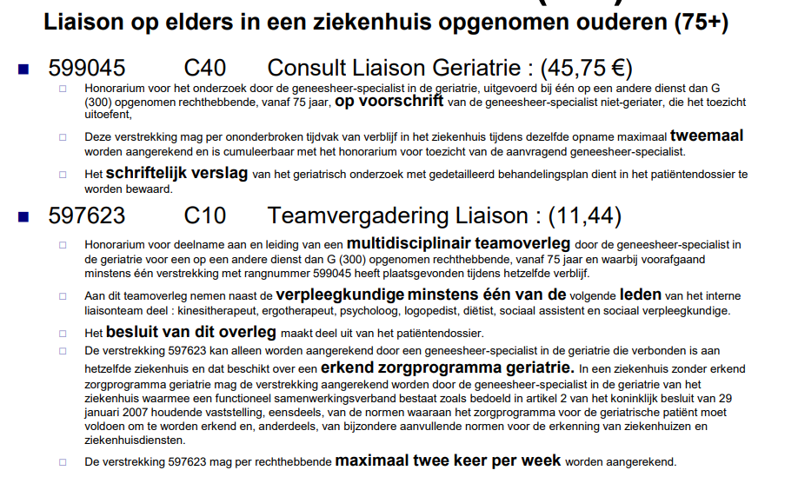
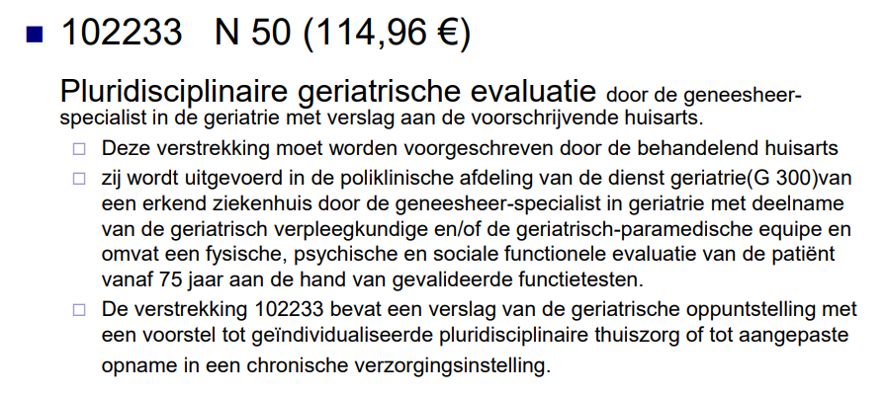

Slide 19
Available evidence in haematology

Slide 20
Study characteristics
First study published in 2006
44 studies, 73% in recent 5 years
Content of CGA
Median of 4 domains
In order of frequency:
IADL, ADL, cognition, mood, physical capacity, polypharmacy, nutrition, frailty, social support
Outcomes
Mortality
Treatment-related toxicity
Treatment completion
Health care utilization
Nothing on quality of life
Haematologica 2020; 105(6): 1484-1493

Slide 21
Association between geriatric impairments and mortality*
ADL, IADL, impaired physical capacity and cognition remained associated with mortality (40%, 62%, 50%, and 50% of studies respectively)°
Frailty (by screening tool or by summarizing CGA) was associated with mortality in at least 75% of all studies assessing frailty°
Age and comorbidity remained asociated with mortality; WHO performance status however did not°
Scheepers et al. Haematologica 2020; 105(6): 1484-1493
° Multivariate analysis
* 33 studies

Slide 22
Association of geriatric impairments with treatment-related toxicity*
4 out of 6 studies assessing frailty found an association between frailty and treatment-related toxicity
Minimal evidence for IADL, physical capacity or cognition*
Scheepers et al. Haematologica 2020; 105(6): 1484-1493
* 10 studies

Slide 23
Association of geriatric impairments with treatment completion*
4 out of 5 studies found an association between geriatric impairments and treatment completion
Risk of treatment non-completion was significantly higher in frail patients*
Limited evidence for malnutrition in NHL
Limited evidence for IADL, physical capacity or cognition in AML or MDS
Scheepers et al. Haematologica 2020; 105(6): 1484-1493
* 5 studies

Slide 24
Association of geriatric impairments with healthcare utilization *
6 out of 7 studies found an association between geriatric impairments and health care utilization
Evidence for physical capacity, ADL, IADL, cognition, and mood in 1 or more studies
Scheepers et al. Haematologica 2020; 105(6): 1484-1493
* 7 studies

Slide 25
From theory to practice

Slide 26
Impact of CGA on decision-making
424 patients with haematological malignancy (>> AML, MDS, lymphoma)
Referred to oncogeriatric consulting team (OGCT) by haematologist, based on clinical judgement – before initial treatment plan or throughout treatment plan
OGCT was informed about hematologist initial treatment suggestion before CGA
Change in treatment plan was proposed for 21,7% of patients
Palliative care in 11,3%
Decrease in dose in 0,9%
Protocol change in 4,2%
CGA in light of reassessment in 3,5%, with 9 out of 15 continuing chemotherapy
No information on outcome nor geriatric interventions
Garric et al. Eur J Haematol. 2021; 106: 616-626

Slide 27
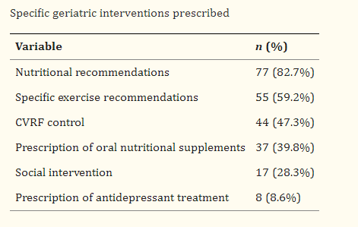
CGA performed by a geriatrician 1-2 weeks before start of treatment
Implementation of interventions
Follow-up every 3 months
Type I: robust
Type II: pre-frail, with potentially reversible deficits
Type III: frail, with irreversible defits
Type IV: requiring palliative care
Notes:
Treatment was chosen on a tailored basis, considering patients’ values and preferences, by the hospital’s multidisciplinary lymphoma tumor board. Oncospecific treatment differed significantly across groups (p<0,001), with adapted regimens (64,5%) being more frequent in type II and III-IV patients (p 0,001). The rate of subsequent treatment modifications did not vary between groups. 14% of patients discontinued treatment due to side effects, with similar rates of severe (< grade 2) toxicity and discontinuation due to toxicity observed across groups. There were no differences regarding the need for subsequent treatment adjustments (modifcation or discontinuation of the initial treatment).

Slide 28
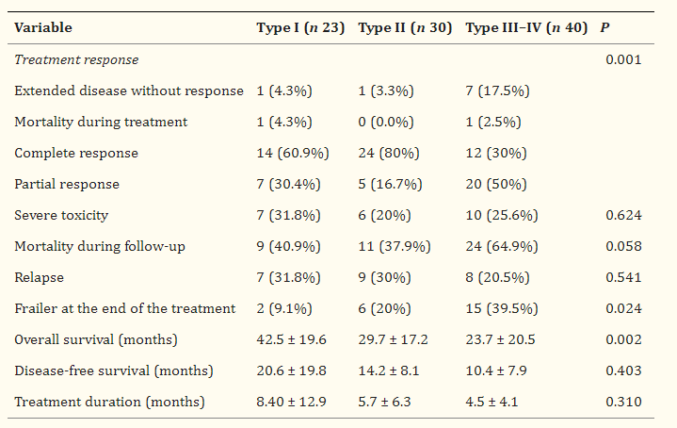
Treatment based on CGA, patients’ values and preferences by a multidisciplinary board
More frequent adapted regimens in type II and III-IV
Similar rates of severe toxicity and discontinuation

Slide 29
To validate a simplified GA (sGA) as an independent prognostic factor for OS
To develop and validate the Elderly Prognostic Index (EPI)
Prospective, multicentric, observational study
1207 patients, median age 76 years
Merli et al. JCO 2021; 39: 1214-1222

Slide 30
Merli et al. JCO 2021; 39: 1214-1222
Notes:
IADL volgens Lawton met blijkbaar 8 items
1ste en derde kolom: alles AND
2de en 4de kolom: and/or behalve voor leeftijd waar het opnieuw AND is.
Chemotherapy regimens
were classified comparing the actual delivered
anthracycline dose with the theoretical dose calculated for
each patient for the whole treatment program. Treatments
were grouped as either full dose (FD; from 70% to 100% of
theoretical dose) or reduced dose (RD; , 70% of FD)12;
regimens that did not include anthracyclines were grouped
together in a third group of palliative therapies (PTs).

Slide 31
Merli et al. JCO 2021; 39: 1214-1222
Notes:
Our validation of this new sGA to predict OS of older patients with DLBCL adds a significant contribution to the integration of geriatric assessment in the initial evaluation of these patients. Thanks to the large study population of
the Elderly Project, we were able to definitively show the existence of an intermediate group of unfit patients, thereby improving the previously adopted two-group model. We simplified our oGA by using age slightly differently
in the definition of fitness status as reported in Table 1.
The sGA groups, International Prognostic Index (IPI), and
hemoglobin level were considered as the most important
prognostic factors to build the Elderly Prognostic Index
(EPI) with a multivariable Cox PH regression model (the
building of the model and the assessment of its adequacy
are reported in the Data Supplement).

Slide 32
Merli et al. Cancers 2023; 15: 5845
Notes:
Finally, alongside the classical and evergreen R-CHOP, new therapeutic
strategies, i.e., monoclonal antibodies and chemo-free approaches, are expanding the
curative armamentarium of DLBCL. These novel therapies are critical to improving the
outcomes of hard-to-treat older patients. In this regard, Figure 4 is the author’s own attempt
to allocate new treatments to older patients assessed by EPI, sGA, and age.

Slide 33
Let’s focus on some details

Slide 34
Advices ILT
We weerhouden uit het assessment van 12/04/2024:
- Sociaal: samenwonend met vriend (13jaar jonger), hebben geen kinderen. Heeft 1 zus waarmee een goed contact
- Woning: appartement, lift is aanwezig
- Activiteiten dagelijks leven (ADL): zelfredzaam
- Instrumentele activiteiten dagelijks leven (iADL): zelfstandig. Vanaf 15/04 zou er 1x/14dagen poetshulp starten.
- Rijgeschiktheid: rijdt met de wagen
- Mobiliteit: autonoom zonder loophulpmiddel, geen valincidenten
- Cognitie: adequaat
- Stemming: probeert positief te blijven maar voelt dat het moeilijker wordt. Vermoeidheid speelt vooral parten.
- Slaap: geen slaapproblemen
- Voeding: G:73kg, - 3 kg, weinig eetlust weinig smaak.
- Continentie: continent, klachten van obstipatie, laxativa opgestart.
- Pijn: geen pijnklachten tijdens bilanafname. Vooral zeer moe
- Decubitus: verhoogd risico (magere man + ligt momenteel veel in bed)
- Visus: leesbril
- Gehoor: gehoorproblemen waarvoor hoorapparaten
Arthur, 78 years
- Stemming opvolgen: indien nodig consult psycholoog
- Consult diëtist te plaatsen: graag bekijken voedingsintake + eventueel opstart bijvoeding. Vriend zou 'astronautenvoeding' hebben meegebracht
- Opvolgen decubitus: indien nodig wisselhouding of anti-decubitusmatras te voorzien
- kiné: indien toestemming arts gangrevalidatie te starten

Slide 35
Malnutrition in real life
High prevalence of malnourishment in newly diagnosed patients
40% decreased food intake
31% pronounced unintentional weight loss
43% at risk for malnutrition and 15% manifest malnourishment (MNA)
Severe decreased food intake, >3kg weight loss, impaired MNA and low serum albumin were significantly associated with shortened overall survival at 2 years.
Most unfavorable outcome was seen in patients with AML and MDS
Stauder et al. Hemasphere 2020; 4: 1

Slide 36
2 pairwise cohorts of malnourished patients, 11790 patients in each
1:1 propensity score matching – nutritional support versus no nutritional support
Notes:
This was a retrospective cohort study using a nation-wide population-based database from Switzerland to investigate the association between nutritional support and clinical outcomes in malnourished cancer patients. We used administrative claims data from the Federal Statistical Office of Switzerland (“Medizinstatistik”)1 and observation period was from April 2013 to December 2018. The database contains all Swiss inpatient discharge records from acute care-, general-, and specialty hospitals, and provides information about in-hospital healthcare use, main diagnosis and comorbidities, diagnostic tests and procedures. Data assessment was longitudinal with each patient having a unique code, so that re-hospitalization could be tracked and one patient could have more than one index hospitalization. Main diagnoses and comorbidities were assessed during index hospitalization and coded using the International Classification of Disease, version 10, German Modification (ICD10-GM) codes; in-hospital therapeutic procedures were recorded using the “Swiss classification of operation” codes (CHOP). The institutional review board of Northwestern Switzerland (AG/SO 2009/074 and EKNZ BASEC PB_2017-00449) approved the trial, including waiver of informed consent of the patients because data was de-identified. We followed the Strengthening the Reporting of Observational Studies in Epidemiology (STROBE) reporting guidelines (14).

Slide 37
In-hospital mortality was lower in the nutritional support group.
No difference in 30-days readmission rates
Discharge to a post-acute care facility was less frequent in the nutritional support group.
Two exceptions: patient groups with hematological cancer and on chemotherapy both did not show significant survival benefit
Plea for future well-designed clinical trials for nutritional interventions in (hematological) cancer patients undergoing chemotherapy.

Slide 38
Polypharmacy in real life
What is day 1 ?

Slide 39
Polypharmacy in real life
62 patients, median age 77 years
Polypharmacy (≥ 5 medications/day):
48.4% at baseline
98,3% 2 months after start of therapy
Independent medication management (Lawton):
79% at baseline
43.4% 2 months after start of therapy
Velghe et al. Eur J Oncol 2016; 21(1): 14-20
Notes:
Als belangrijkste oorzaak daarvoor zien wij de sterke stijging in het aantal geneesmiddelen dat de patiënt ten gevolge van zijn behandeling moet innemen. Gemiddeld nemen de patiënten tijdens hun behandeling 9 verschillende geneesmiddelen en 11 pillen per dag.

Slide 40
Polypharmacy in real life
Implications for clinical practice
No spontaneous report of potential problems
Clinicians fail to predict correctly a patient’s cognitive and/or functional capacity to manage medication
Often taken over by the spouse (of the same age)
Patients living alone
problem of medication adherence
Velghe et al. Eur J Oncol 2016; 21(1): 14-20
Notes:
Wat vooral alarmerend is, is dat patiënten niet spontaan melden dat zij problemen hebben en een klinische blik niet volstaat om in te schatten of een patiënt al dan niet problemen zal ervaren. Bij patiënten die samenwonen wordt het medicatiebeheer vaak overgenomen door de partner. Alleen is deze vaak even oud als de patiënt zelf en is de kans dus groot dat deze tegen dezelfde problemen opbotst. Patiënten zonder partner lopen het risico aan hun lot overgelaten te worden. In beide gevallen is de kans op therapie-ontrouw reëel.

Slide 41
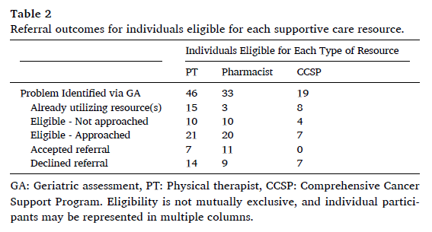
60-plus with MM
One or more deficits identified by GA on most recent registry
Physical function
Polypharmacy
Anxiety or depression
Referral to
Physical therapy
Clinical pharmacist
Comprehensive cancer support program
58 patients included
Jensen et al. J Ger Oncol 2024

Slide 42
58 patients included
50% accepted, 50% declined
Acceptance of PT higher in patients that fell
Reasons for not referring:
Physician forgot
Physician chose not to based on their assessment of patient’s physical or psychological condition
Feasibility?
High acceptability (4.4/5)
“comforting”, “thorough”, “support”, “communication”, “assistance”, …
Jensen et al. J Ger Oncol 2024
Notes:
The primary (feasibility) outcome was assessed among the remaining 32 individuals who were approached regarding a referral to at least one new resource. Within this group, 16 (50% of approached) accepted a referral to at least one resource, and 16 (50%) declined all offered referrals.
Referral acceptance rates were highest among those recommended for a pharmacy visit (55% of those approached) and lowest for CCSP (0%) (Fig. 2). The overall acceptance rate for PT referrals was 33%, with an acceptance rate of 43% (95% CI: 17–69%) among participants who had experienced falls, versus 14% (CI: 0–40%) among those without falls, but qualified for a PT referral based on IADL impairment(s).
Several reasons were cited by the 16 registry participants who declined all referrals. Two (13%) participants cited a desire to limit travel to non-essential appointments, three (19%) reported they did not think physical therapy (PT) would be helpful for their functional limitations, and five (31%) reported they had previously completed PT and could do similar exercises at home. Additionally, three (19%) participants felt overextended by their existing medical care and three (19%) stated they did not feel comfortable discussing anxiety symptoms with anyone.
… providers identified two factors limiting referrals: (1) provider was prompted to make a recommendation during a clinic visit but forgot (8 of 13 cases) and (2) provider was prompted to make a referral but chose not to based on their assessment of the patient’s physical or psychological condition during the visit (5 of 13 cases).
Among individuals referred to a pharmacy visit, CPPs recommended discontinuation of an average of 0.4 medications per patient (range 0–2) and recommend another 0.6 medications (range 0–1) be discussed further with their prescriber for possible discontinuation. At time of follow up, patient-reported daily medications were not significantly reduced: mean 􀀀 0.7 (95% CI: 􀀀 2.9, 1.5). EORTC QLQ C30 physical function scores among individuals referred to PT did not differ significantly from before to after intervention (mean change of 4.3; CI -13.9, 22.6). No significant differences were observed in mean IADL scores (mean change 􀀀 0.5; CI -1.4, 0.4) or falls (􀀀 1.7, CI -4.5, 1.0). Regarding the acceptability of the intervention program, among the 16 individuals accepting a referral to at least one resource, the mean satisfaction score with study participation was 4.4 (CI 3.7–5.0) on the 5- point Likert scale (1- poor experience to 5- best experience). In cross referencing participant feedback, positive words such as “comforting,” “thorough,” “support,” “communication,” and “assistance” were used by at least 10 study participants when describing their study experiences, corroborating the high score on the Likert scale.

Slide 43
No impact on survival, EDV, hospital admission or LOS
Improvement of the odds of having EOL care goals discussion
consultation was most valued for
evaluation of cognition
connecting patients to resources
diagnosing frailty
managing non-oncologic comorbidities
optimizing functional status
treating falls
treatment of depression and other mood disorders.
Dumontier et al. Haematologica 2022; 107(5): 1172-1180
Notes:
To this end, our finding that geriatric consultation
increased the likelihood of having documented EOL goalsof-
care discussions is clinically relevant to pre-frail and frail
older adults with blood cancers, many of whom have a
high risk of death regardless of intervention.4,43 Discussing
preferences regarding place of death and resuscitation status
is of paramount importance in frail older patients with
blood cancers; doing so early in the outpatient setting can
reduce intensive care use in the days before death while
increasing hospice enrollment.44 Moreover, a geriatrician’s
evaluation of age-related vulnerabilities (e.g., functional and
cognitive impairment) and their potential reversibility better
informs these goals-of-care discussions.42 Many frail
older patients may have other advanced conditions that
limit their prognosis independently of their cancer or its
treatment, diminishing the benefits and increasing the
harms of intensive chemotherapy. Indeed, our trial population
had high rates of cognitive, functional, and mobility
impairment, more representative of patients aged ≥75 years
treated in practice than the small number of patients in this
age group enrolled in clinical trials.4,45
Beyond aligning EOL care with patients’ preferences, the
geriatricians’ expertise in evaluation and management of
age-related vulnerabilities was highly valued by surveyed
hematologic oncologists and other clinicians at Dana-
Farber. Most rated geriatric consultation to be useful in the

Slide 44
Take home messages
The older a patient, the more likely he’s frail – but older might be younger than you think
Despite a lack of hard evidence, CGA remains the most useful tool for now to detect frailty
CGA implies the involvement of a multidisciplinary team
Don’t just look for impact on mortality, treatment toxicity and healthcare utilization, also embrace “thorough”, “comforting” and “supportive”
Start co-operating to build up expertise

Slide 45
