Slide 1
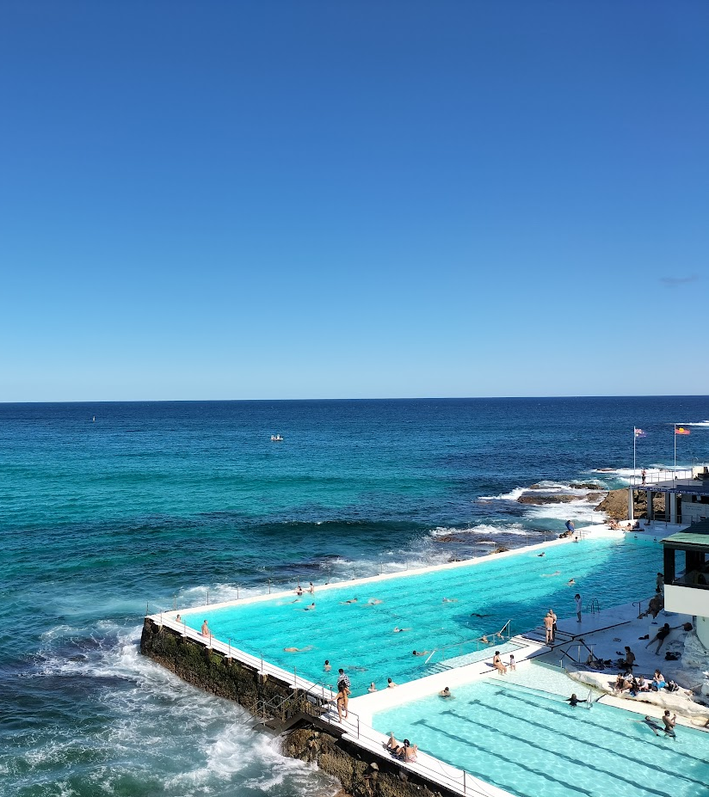
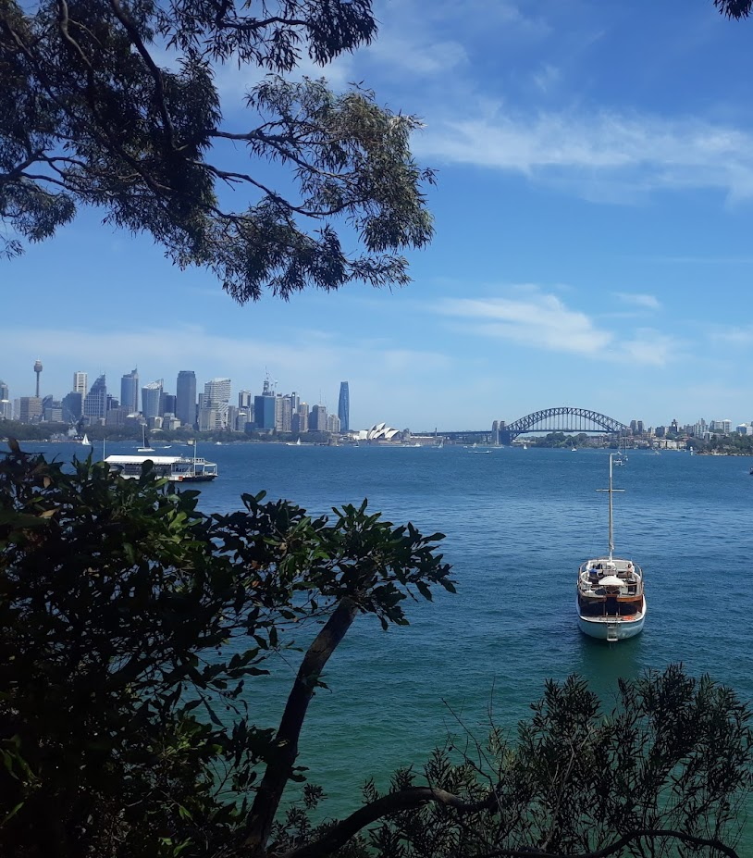
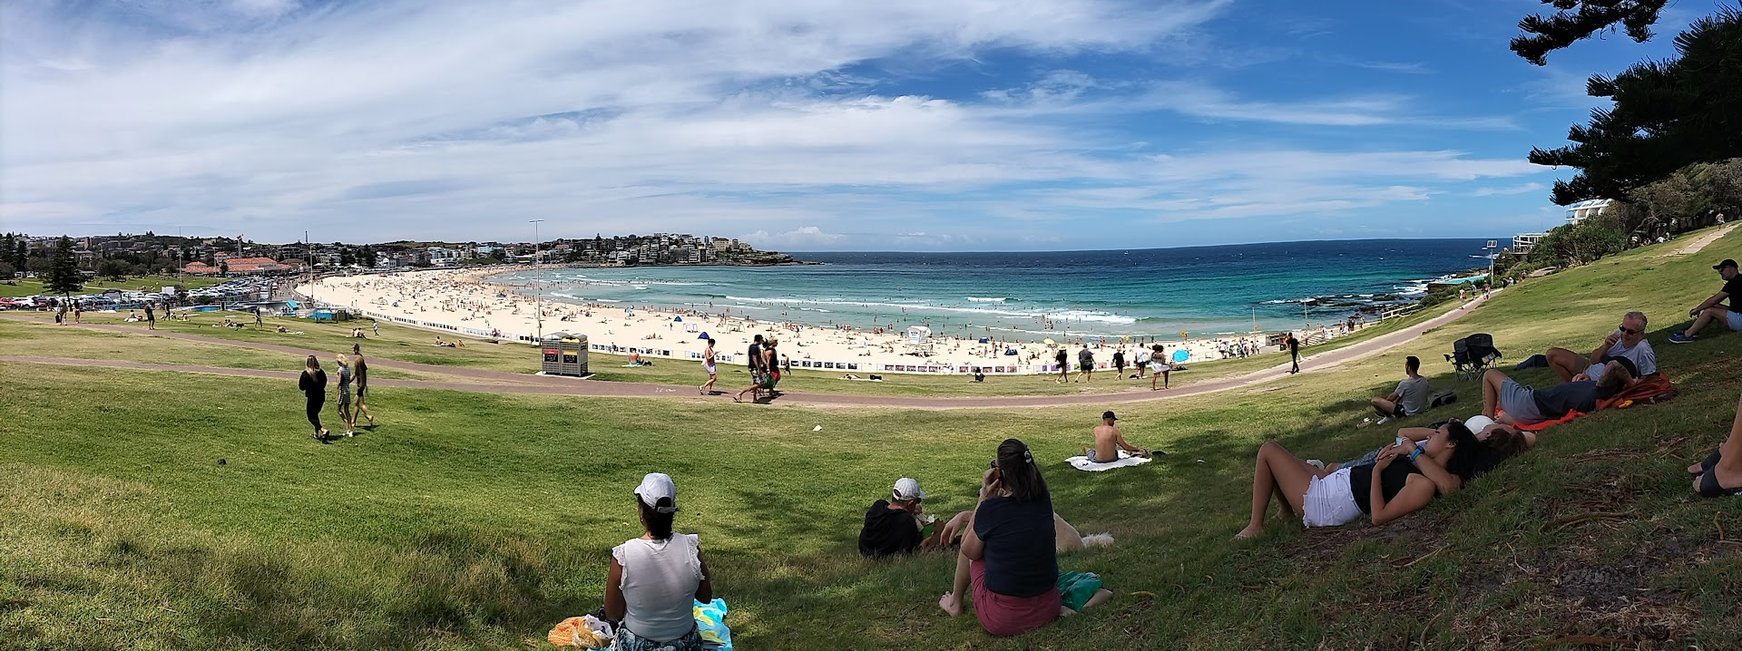
Grant Opportunity: a Fellowship in Sydney

Slide 2
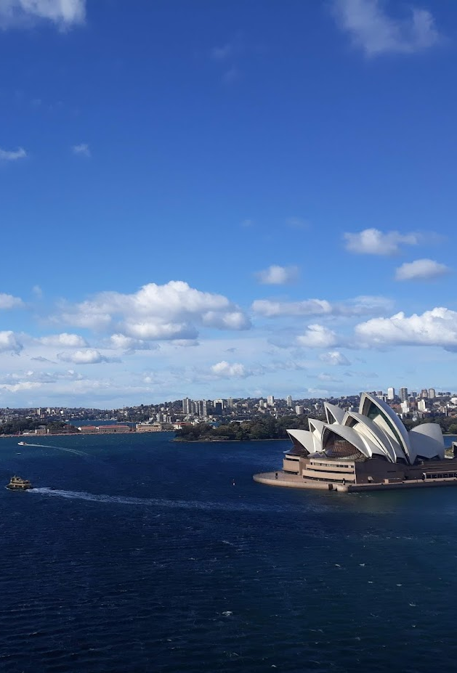
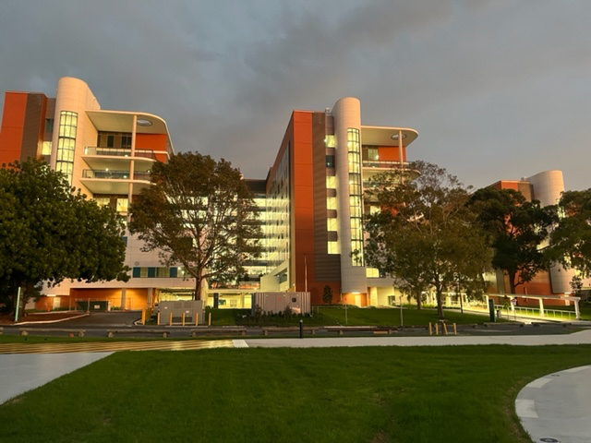
For whom?
Haematology trainee in their final year of training or within 2 years after completion
What?
12 months of training in clinical haematology
Clinics, ambulatory care unit, consults and lab work
Part of a team of australian trainees and international fellows
Where?
Concord Repatriation General Hospital, Sydney, Australia
Department of Haematology and Clinical Research Unit
Accreditated training position in Australia
Brand new facility
Supervision
Accredited supervisors
Professor Judith Trotman – Lymphoma expert.
Clinical research unit + an agreed research project (Mandatory for Research Grant)
Full-time position, no on-call, or afterhours work
Participating in the ALLG lymphoma working group
Professor Ilona Cunningham
Good English knowledge.

Slide 3
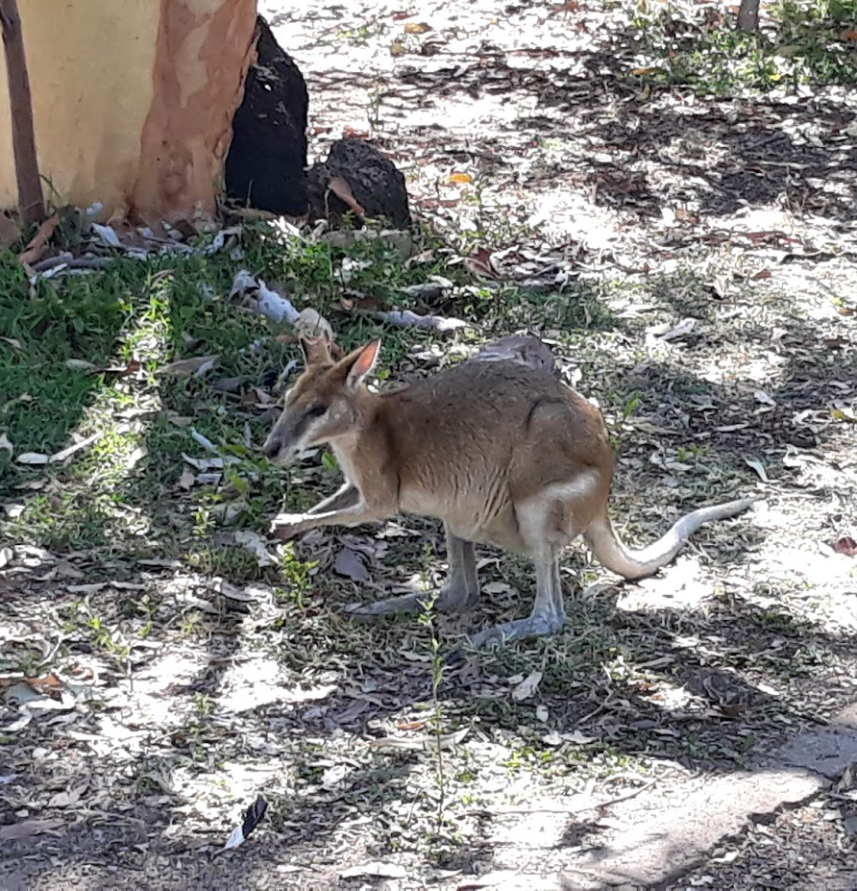
Research Grant details
Partial funding for 1 trainee/per year of $30 000 AUD – must be involved in a lymphoma research project
Funds paid after arrival in Australia (mid-way during the year once evidence of substantial progress in research or audit project)
Additional funding from Belgium mandatory
Proof of financial autonomy also mandatory for Working VISA application
Cost of living one year in Australia:
35 000 AUD for 1 ( about 23 000 euros)
50 000 AUD for 2 ( about 35 000 euros)
Cost of application: about 2500 euros in 2020.
Process takes about 6 - 8 months – Helped by Concord Hospital MADU Department for each step
English requirements:
IELTS/TOEFL/OET passed within 6 months prior to AHPRA application.
High score requested: e.g 7/9 in each section and 7/9 on average- with only 2 attempts.
Interview will be organised to assess English level during selection process
Position could start either in October or March to match Belgium training schedule → October/November 2023

Slide 4
If interested for October/November 2023: 1. CV / resume 2. Written letter of application 3. Name of 2 referrees (+ email addresses), one must be a supervisor → who can provide a letter of recommandation. ➔ SEND TO : judith.trotman@health.nsw.gov.au + Pr Marc André (CHU Godinne) in copy marc.andre@chuuclnamur.uclouvain.be ➔ !! Before 15/12/2022 ➔ Interview will be organised in Jan 2023 (Pr Trotman and Pr André). ➔ Selection will be made by mid-Feb 2023. - For any questions regarding process/training/experience: raedemaekerjuliette@gmail.com

